Slide 1
Web Accessibility 101
Monica Olsson, Marilyn Varela, Greg Gamble, & Shaun Hegney
May 19th, 2022

Slide 2
Who are we?
Monica Olsson, Accessibility Policy Associate
Marilyn Varela, Website Administrator
Greg Gamble, IT Application Development
Shaun Hegney, Program Specialist

Slide 3
Agenda
Section 1: Intro to Web Accessibility, Disability, and the Legal Landscape
Section 2: WCAG and POUR Standards with Omni demo
Section 3: Screen Reader Demo with Shaun
Section 4: Web Development Basics

Slide 4
Housekeeping Items
Today is GAAD!
The slide deck presentation
  Full URL: Web Accessibility 101 - May 19th 2022.pptx
Short break after Part 2
Live transcription is provided
Link to our presentation materials

Slide 5
Section 1
Intro to Web Accessibility

Slide 6
What is Web Accessibility?
Web accessibility means that websites, apps, digital tools, and content are designed and developed so that people with disabilities can use them. More specifically, people can:
Perceive, Understand, Navigate, and Interact with the Web
Contribute to the Web
Resource: W3C WAI Introduction to Web Accessibility

Slide 7
What does Accessible mean?
"Accessible” means that individuals with disabilities are able to independently acquire the same information, engage in the same interactions, and enjoy the same services within the same timeframe as individuals without disabilities, with substantially equivalent ease of use. (University of Montana 2014 OCR Resolution Agreement 10122118)

Slide 8
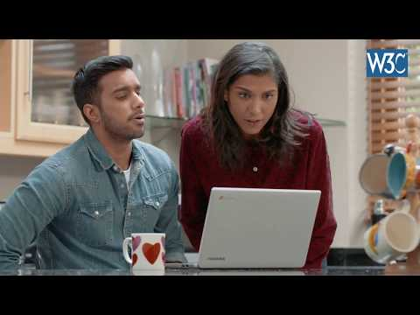
Let's Watch a video
4-minute video: Introduction to Web Accessibility and W3C Standards

Slide 9
What is Web Accessibility Cont.
The W3C Web Accessibility Initiative (WAI) develops internationally recognized technical guidelines for defining and creating accessible web content: WCAG 2.1 AA

Slide 10
What is disability?
The Americans with Disabilities Act (ADA 1990) defines disability as:
A person who has a physical or mental impairment that substantially limits one or more major life activity. This includes people who have a record of such an impairment. It also includes individuals who do not have a disability but are regarded as having a disability.

Slide 11
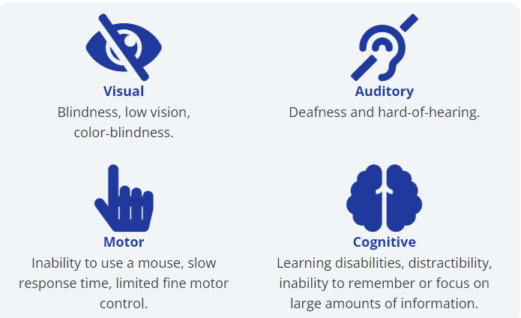
Disability and the web

Slide 12
Legal Landscape: ADA and 504
Federal Laws: Americans with Disabilities Act and Section 504
  People with disabilities cannot be denied services or program access due to their disability.
  Entitled to use appropriate accommodations.
  Access to material of the same quality and within the same time frame as people without disabilities.

Slide 13
Legal Landscape
Federal Law: Section 508 of the Rehabilitation Act.
Requires Federal Electronic and Information Technology to be accessible to people with disabilities.
Learn more about the 2017 Section 508 Refresh.
    Focus on functional technical requirements and aligns with WCAG standards.

Slide 14
Legal landscape: Policy 188
State Law: OCIO Washington Policy 188
All state agencies must meet minimum IT technical accessibility standards: WCAG 2.1 AA
    The procurement, development, and implementation of instructional, administrative, or communications technologies and content.
    College websites, learning management tools, student information systems, training materials, instructional materials, and assessment tools.

Slide 15
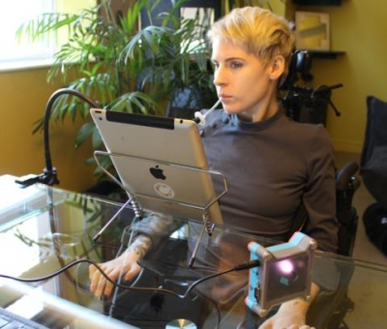
Intro to Assistive Technology
Hardware and software (low and high tech) that helps people with disabilities complete a task.
Screen readers
Voice Command
Mouth stick
Adaptive keyboards/mice

Slide 16
Section 2
WCAG and POUR

Slide 17
What, How, and Why
What is the standard our website must meet?
How do we know if we meet it?
What happens if we don’t provide accessible web pages?

Slide 18
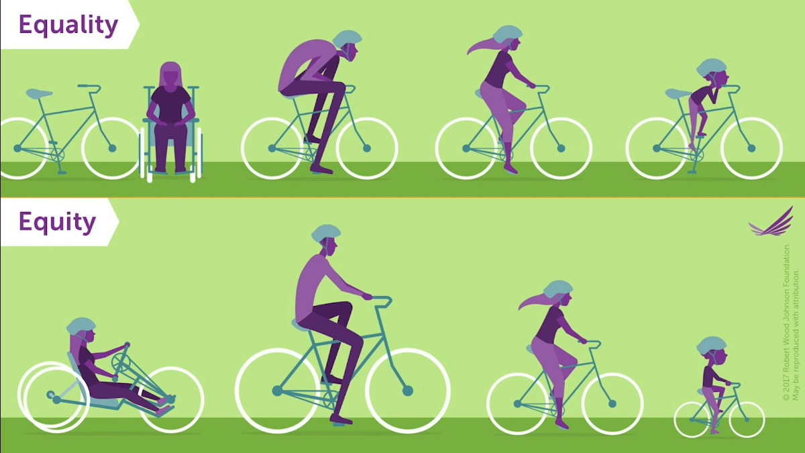
One Size Doesn’t Fit All
© 2017 Robert Wood Johnson Foundation
May be used with attribution.

Slide 19
WCAG 2.1 AA
WCAG stands for Web Content Accessibility Guidelines
Current Standard is 2.1
A = low
AA = medium
AAA = high

Slide 20
POUR
Perceivable
Operable
Understandable
Robust

Slide 21
Perceivable
Provide text alternatives for non-text content such as charts and graphs
Include alt tags for images
Put captions on videos
Include an audio description of what is happening in a video. On-screen text, characters actions, scene changes etc.

Slide 22
Operable
Ability to input information in form fields through a keyboard or mouth stick. Word documents, Google documents and pdfs.
Tab items in the correct order.
Headings that describe topic or purpose.
Touch targets big enough for large or impaired fingers.

Slide 23
Understandable
The site functionality should be easy to navigate.
Links should be obvious and indicate where they will take the user
Consistent and predictable navigation
Form controls must be labeled (Greg will cover this)

Slide 24
Robust
Use valid HTML and ARIA (Accessible Rich Internet Applications)
A telephone number input field in 3 parts must announce all three parts: area code, prefix and suffix.
Don’t use a div or a span tag for a button instead of the button html code.

Slide 25
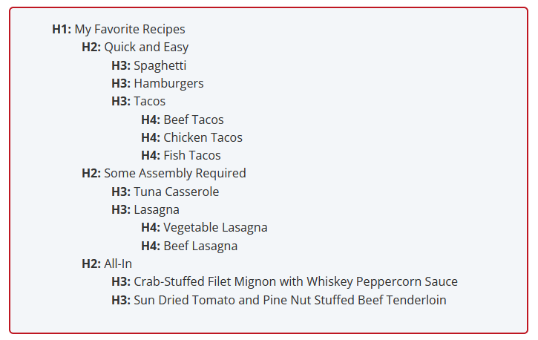
Heading Structure
Don’t skip heading levels
Think of headings like a nested list
Notes:
Image needs alt text

Slide 26
Alt Text
Basic Rules of alt text
  Do not use picture of or image of in description
  Use correct grammar and punctuation
    Capitalize the first letter
    End whole sentences with a period
  Siteimprove Article on Alt Text Best Practices
Notes:
Make link accessible

Slide 27

Hyperlinks
No more click here
Don’t use read more
Use descriptive links that tell the user where they will go

Slide 28
Color Contrast and Tables
Use color palettes from Communications on StaffNet
Don't use tables for layout. Tables are for data.
Use simple table structure or mark up complex tables correctly making sure there are headings.

Slide 29
Demo
How to check for accessibility on your pages
How to use styles for tables
How to set header row for tables and column scope
Broken accordions

Slide 30
Reference
W3C Quick Reference
  https://www.w3.org/WAI/standards-guidelines/wcag/
DigitalA11Y cheat sheet by WCAG 2.1 AA Checkpoint https://www.digitala11y.com/wcag-checklist/
https://bighack.org/5-most-annoying-website-features-i-face-as-a-blind-screen-reader-user-accessibility/
Blog on Contrast Ratios - https://www.boia.org/blog/how-contrast-ratio-pertains-to-website-accessibility
Notes:
Need to make links accessible

Slide 31
Questions?
Thank you for making your web pages awesome for all!

Slide 32
Break
5 minute Break

Slide 33
Section 3
Screen Reader Demo with Shaun

Slide 34
URLs for Shaun's tech demo
Good page demo:
  Full URL: https://www.sbctc.edu/_testing/accessibility-demo-good.aspx
Bad page demo
  Full URL: https://www.sbctc.edu/_testing/accessibility-demo.aspx
NVDA Keyboard Commands Resource
  Full URL: https://dequeuniversity.com/screenreaders/nvda-keyboard-shortcuts

Slide 35
Screen Reader Basics
A Screen Reader is a piece of software that reads text, navigational elements, and other information to a user who may be low vision or fully blind.
Allows independent navigation of a computer or mobile device even if a user has no vision.
Screen Readers may be first-party software built into an operating system like Voice Over (Apple iOS and macOS), Windows Narrator (MS Windows) or offered separately by third-party developers such as NVDA or JAWS (MS Windows only.)
Notes:
Shaun's slide

Slide 36
Section 4
Web Development Basics

Slide 37
Links and resources
Example site:
  Full URL:
  https://devapps.sbctc.edu/AccessibilityTraining
ARIA: alert role:
  Full URL: https://developer.mozilla.org/en-US/docs/Web/Accessibility/ARIA/Roles/alert_role
ARIA: aria-atomic:
  Full URL: https://w3c.github.io/aria/#aria-atomic

Slide 38
What we will cover
Bootstrap Framework and Semantic HTML
Alerts and Aria
Basic form and input labels
Modals

