Slide 1
Guided pathways advisory council
Spring 2023

Slide 2
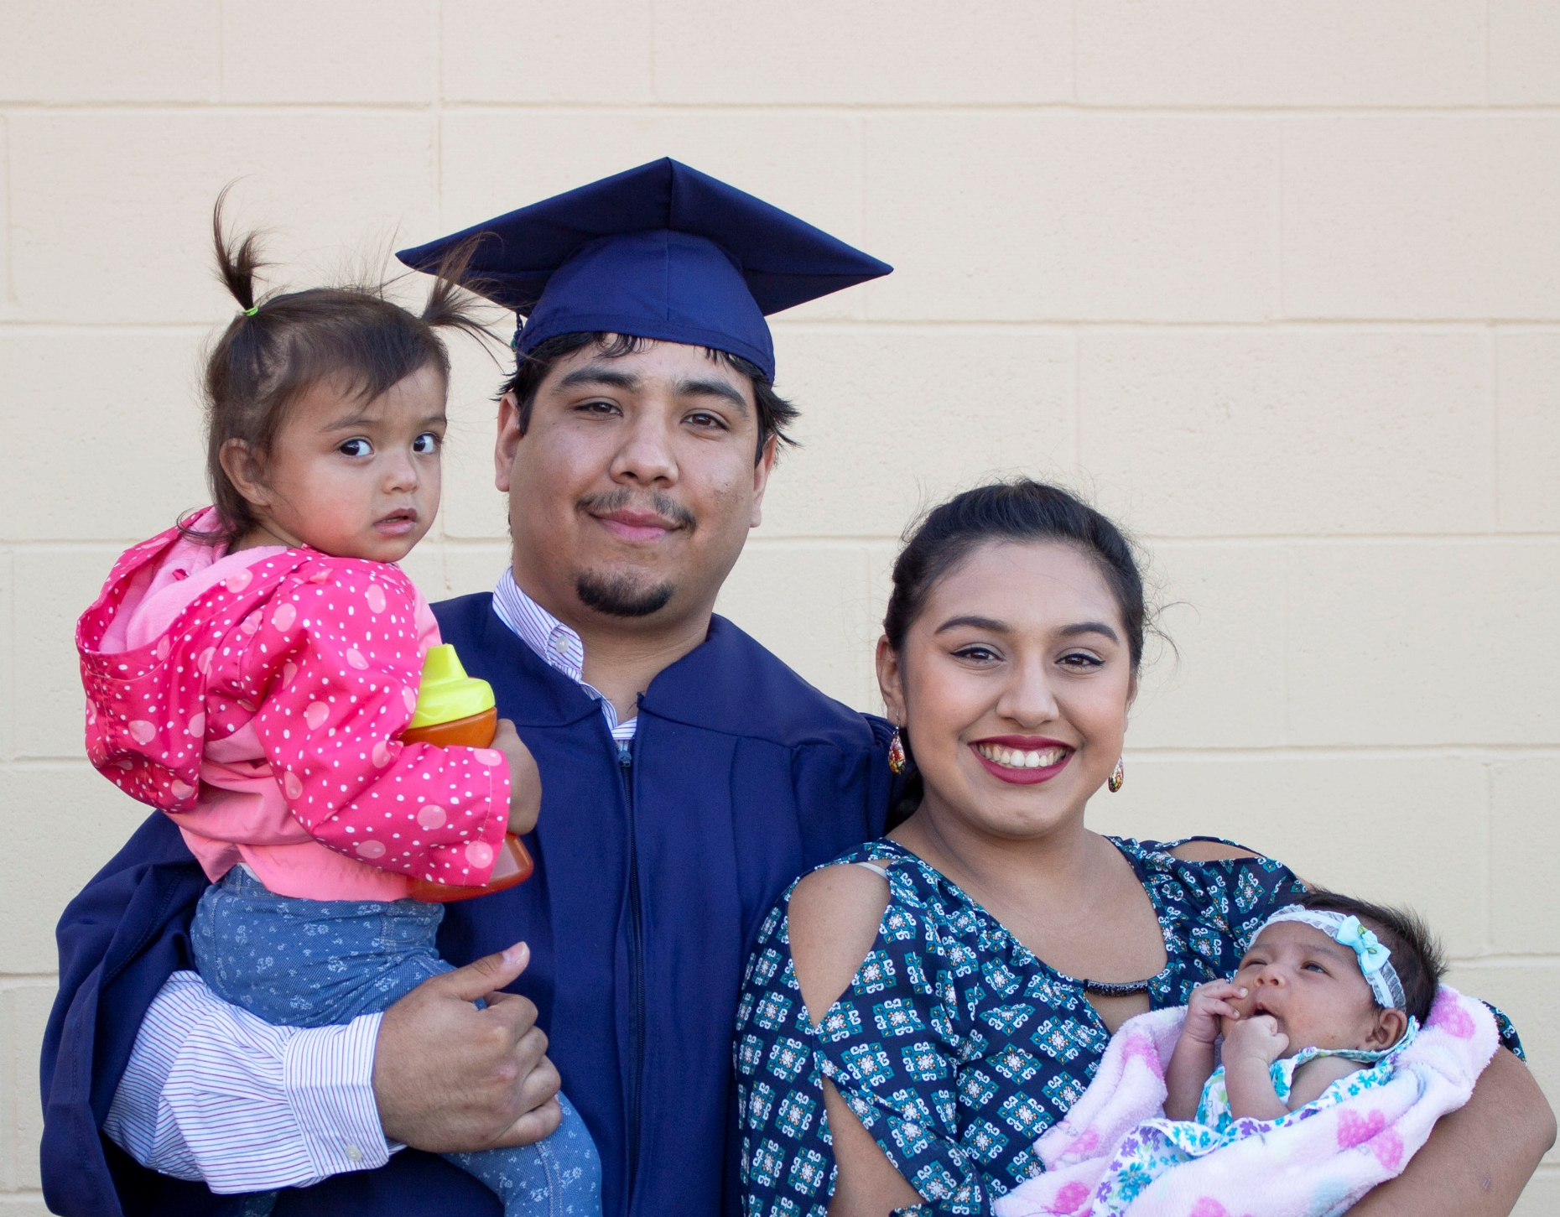
Commencement Season

Slide 3


Slide 4

Happy pride!
Housing and Resources
Host affirming events
Educate community members on LGBTQ+ issues
Address LGBTQ+ needs in mental health supports
Foster LGBTQ+ student/staff relationships
How is your college Advancing queer student success?
Notes:
https://www.insidehighered.com/news/student-success/college-experience/2023/06/21/five-programs-support-lgbtq-student-success

Slide 5
Work plan Overview
Large Scale Change
Pathway Entry
& Navigation
Data Analytics
Pathway and Program Design
Equity informed project and change management infrastructure
Comprehensive mapping of student educational pathways with student end goals in mind
Students make informed program choices and develop completion plans
Data analysis of student learning as well as program and service outcomes
Success Support
Infrastructure
High impact practices in teaching and learning
Auto populated with data
Aligned with legislative requirements from the Workforce Education and Investment Act
Redesign cohorts
Inform statewide PD, coaching, and technical assistance.
Released March 4, 2024
Due June 28, 2024

Slide 6
Commission and council sharing
Hot topics?
Focus areas?
Announcements?

Slide 7
Student Success Center Updates
Student Success Tool Request for Proposals
Data Governance Sub-Committee: Meta-Majors
College Spark Washington Math Placement Initiative
Coaching and Technical Assistance
Integrated and Collaborative Planning

Slide 8
Student success tool RFP Updates
Taskforce
RFP Purpose Statement
WACTC
Configuration
SBCTC
RFP process management
Implementation Support
Functional requirements of tools
Review and integrate aggregate RFI data
Stakeholder group communication and feedback
System Management (community pool)
Individual Colleges will determine their buy-in
Vendor relationships, contract management, and invoicing
IT and ctcLink integration
Institutional Instance (backyard pool)

Slide 9
RFP next Steps
Functional Requirement Definitions and Prioritizing
WACTC conversation at retreat
Finalize RFP language (July/August)
Student Goal Planning & Progress | Data and Analytics
Communication | Technology Integration
Student Advising | Client Support
Accessibility and Equity | Costs

Slide 10
Invitation to share
&
Questions

Slide 11
Data Governance Sub-committee on meta-majors in ctclink
Global “Pool” vs Institution defined meta-majors.
  How to associate local meta-majors to a global program grouping for system-wide reporting?
How do we determine a meta-major for programs such as the general DTA that can be associated to more than one meta-major?
How do we determine a meta-major for non-credential plan codes such as transitional studies, non-award seeking and apprenticeship?

Slide 12
Invitation to share
&
Questions

Slide 13
Pilot Project: HS Transcript Placement Agreement
Within two years of graduating from a Washington high school, students may use either the letter grade earned in the second term of a high school mathematics course or their overall cumulative high school GPA to determine their mathematics placement at any of the Washington Community and Technical Colleges (CTCs) piloting this agreement.
The placement options outlined set a minimum guaranteed placement; individual CTCs may use their own locally determined processes to place a student into a higher level mathematics course.

Slide 14
Current Placement practices
27 use HS Coursework for math placement
  8 report using HS GPA for math placement
21 use DSP/GSP in their placement process
  4 additional colleges are in the process of creating a DSP/GSP
13 report using both HS transcripts and GSP/DSP

Slide 15
Pilot Project: Placement Grid
2024-2025 Pilot Colleges:
Cascadia College
Everett Community College
Lower Columbia College
Renton Technical College
Tacoma Community College Running Start
High School Transcript | Grade Range | Recommended Minimum Placement
Algebra II (2056) OR Integrated Math III (2064) | B or higher | MATH& 107 Math in Society MATH& 141 Precalculus I MATH& 146 Introduction to Statistics
 | C or higher | MATH& 107 Math in Society MATH& 146 Introduction to Statistics
Bridge to College Math (WA0003) OR Statistics (2203) | B or higher | MATH& 107 Math in Society MATH& 146 Introduction to Statistics
Precalculus (2110) OR Math Analysis (2104) | B or higher | MATH& 142 Precalculus II MATH& 148 Business Calculus
 | C or higher | MATH& 107 Math in Society MATH& 141 Precalculus I MATH& 146 Introduction to Statistics
Calculus (2121) | C or higher | MATH& 151 Calculus I
Cumulative GPA (HS Graduates) | GPA ≥ 3.0 | MATH& 107 Math in Society MATH& 146 Introduction to Statistics

Slide 16
Looking Forward: developing Guidance
Populations
Multiple Measure Options
Running Start
Homeschool
High Schools outside WA
HS+
Veterans
International Students
Returning Students
GED
ACT or SAT
Smarter Balance Assessment
Credit for Prior Learning
Guided and/or Directed Self Placement

Slide 17
Invitation to share
&
Questions

Slide 18
Guided Pathways coaching
Thank you to Jon Kerr and Debra Gilchrest!
Hard reset for 2025-2026
  Build capacity for coaching stance across system
  Institutional and system impact
  Aligned with SBCTC leadership development
  Emphasis on emerging and middle leaders
  Center student success and racial equity with an intersectional lens
  Problem and project based
  Integrated student engagement and leadership

Slide 19
Planning for 2024-2025 and beyond
Work Plan
Evaluations and feedback
Commission and Council needs
Pathway pillars
Equity advancing high impact practices

Slide 20
Gpac Structure
Members
Leadership
WACTC (7)
Commissions:
  Equity Officers (1)
  Instruction (2)
  Student Services (1)
  Research and Planning (2)
  Information Technology (2)
  Human Resources (1)
  Public Information (2)
Faculty (2)
SBCTC staff
Student (1)
Reports to WACTC Educational Services Committee
To date:
  No Executive Committee
  No sub-committees

Slide 21
Commission Conversation Themes
WACTC
Capacity
Student Services Commission
Student Success RFP
Financial aid simplification
Instruction Commission
Clarity on metrics and accountability
Diversity Equity Officer Commission
Research and Planning Commission
Promising practices in GP
Faculty ownership and engagement
Going all in on transformation
Mapping to the Student
Assessment, Teaching and Learning,
Leading with racial equity
Alignment and putting it all together
Strengths and opportunities for role in guided pathways
Deeper system engagement
Ideation on WACTC support for DEOC work institutionally and systemically
Introductions and Connection opportunities
Role for integration around data needs
Professional development—internal to commission and external for councils and colleges

Slide 22
Priority setting for GPAC 2024-2025
What would you like to see prioritized for GPAC? How does this align with your commission priorities?
What actions can GPAC take to elevate the urgency of Guided Pathways and equity focused transformative change?
What suggestions or ideas do you have around the structure of GPAC?

Slide 23
Dyad Debrief
What were highlights from your discussion?
What did you notice about your discussion? What was said, what wasn’t?
What are you still curious, or more curious, about because of this conversation?
What do you see as the next steps?
Insert your own question here

Slide 24

Thank you!
Comments, questions, feedback?
2024-2025 calendar to be determined…
Enjoy your Summer!

