Slide 1
Faculty Certification and ProCert Training - January 2025
William Belden, Workforce Education
Greg Gamble, Application Development
Notes:
Bill
Good afternoon and welcome
We appreciate your interest in this presentation and look forward to introducing the new features in ProCert.
Today, Greg launched the updated ProCert site where all of these features are now available.

Slide 2
Agenda
Certification Overview
Accessing ProCert System and Permissions
System User Roles
Administrator/Assistant Administrator
Supervisors
Faculty
Functionality
Resources
Notes:
Bill

Slide 3
Certification overview
Perkins Training: Professional-Technical Faculty Certification
February 11, 2025; 3:00 – 4:30
https://us02web.zoom.us/j/88440729683?from=addon
Requirements WAC 131-16-093 & WAC 131-16-094
Initial 3-year certification upon hiring.
Standard/Renewal 5-year certification/recertification.
Policy guidance on part-time requirements.
Orientation.
First Aid/CPR & Bloodborne pathogens.
Professional development plan (PDP) utilizing Skill Standards.
First Aid/CPR & Bloodborne Pathogens
Required before second quarter of employment.
Examples: Machinery, electric, biologicals, chemicals, excavations, heights, etc.
Training should be in-person, with hands-on, practical application.
Notes:
Bill
A current first-aid certificate, including CPR and bloodborne pathogens, must be earned by professional-technical instructors prior to the second quarter of employment
students into physical proximity with machinery, electrical circuits, biologicals, radioactive substances, chemicals, flammables, intense heat, gases under pressure, excavations, scaffolding, ladders, and/or other hazards.
Responsibility for ensuring that appropriate staff has first-aid training will rest with the assigned chief professional-technical administrator.
The specific type of first-aid program, including CPR, required of professional-technical instructors shall be achieved by passing a course of first-aid/CPR/bloodborne pathogen instruction and participation in practical application of subject matter determined and required by the department of labor and industries.
The training should be in-person, with hands-on, practical application.

Slide 4
Certification overview
Professional Development Plan
Individualized to meet the needs of each faculty.
Includes instructor’s and administrator’s assessment of strengths & opportunities for growth.
Focuses on reaching professional goals as a facilitator of learning.
Activities include measurable outcomes linked to the skill standards.
Timeline for completion of activities.
Minimum of five (5) performance outcomes and related activities. Must include the following Critical Work Functions:
Managing learning environments (Critical Work Function A)
Develop outcomes, assessments, and curricula (Critical Work Function B)
Provide student instruction (Critical Work Function D)
Notes:
Bill & Kimberly?
Add links to pages and resources

Slide 5
ProCert access & Permissions
Professional-Technical Administrator
President appointed
SBCTC Contacts
Policy Guidance: William Belden
Technical Assistance: Greg Gamble
User Manuals
Administration/Administration Assistant
Supervisor/Program Support
Instructor
New site instructions
Notes:
Bill & Greg
User manuals are being updated to reflect the enhancements.

Slide 6
Administrator/Assistant role
College specific settings include:
Default Skill Standards (2024 or 2012)
Required Critical Work Functions (in addition to A, B, & D)
Survey requirements beyond those required by legislation
Notification/reminder defaults
Notifications are sent to supervisors and faculty
Approvals and revisions of PDP
Ensure college policy on faculty certification is current and all processes comply with legislation
Notes:
Bill and Greg
ProCert has been updated with the 2024 Skill Standards. The updated standards will be the only option effective June 30, 2025.
Faculty PDPs created under 2012 Skill Standards will be able to complete their initial or recertification under those standards. Managed at the college level.
Colleges have the option to include additional standards without removing any of the legislatively defined standards.
Each assigned standard requires faculty to complete a self-assessment of their current skills for each Key Activity under that Critical Work Function. The aligned Performance Indicators are built into ProCert with examples of baseline, intermediate, and mastery-level proficiency.

Slide 7
Supervisor/Assistant role
Create faculty accounts in ProCert
Faculty must be entered into the ProCert system during the first term they are deemed to meet certification requirements.
Adjunct Faculty Certification - Policy Guidance (2024)
Manage exemption/verification of first aid/CPR requirement
First-Aid/CPR/Bloodborne Pathogens WAC 131-16-093
Manage exemption/verification of bloodborne pathogens requirement
First-Aid/CPR/Bloodborne Pathogens WAC 131-16-093
Manage faculty orientation requirement
Faculty self-attestation review
Track faculty progress toward meeting required standards
Notes:
Bill
Specifically excluded from conformance to the first-aid requirement are:
Those instructors who teach related subjects to professional-technical students, i.e., mathematics, English, or communications skills, etc., when such subjects are taught in classrooms rather than shops or laboratories.
Physicians, registered nurses, licensed practical nurses, and others when their occupational competencies and training include first-aid knowledge and skills equal to or superior to that represented by the first-aid certification being required under these regulations.

Slide 8
Faculty role
Self-attestation of required orientation – provide year/quarter.
Self-assessment of Skill Standard proficiency level for each required Critical Work Function.
Self-assessment of current skills for each Key Activity. Performance Indicators are built into ProCert with examples of baseline, intermediate, and mastery-level proficiency.
Development of PDP.
Requires selection of five Key Activities for initial and standard/renewal.
Track progress of certification, noting completions and milestones.
First Aid/CPR/Bloodborne Pathogens certification.
Notes:
Bill
Add links to pages and resources
Faculty completing the Skill Standards survey will be asked to self-attest they have completed their required orientation.
Supervisors verify and confirm the accuracy of the entries prior to approval.
For each legislatively required Standard, faculty must self-assess their level of proficiency (baseline, intermediate, and mastery-level) for each Key Activity under that standard.
Based on their self-assessment, the faculty will need to select one Key Activity for the PDP.

Slide 9
Procert Demonstration

Slide 10
Important elements
ProCert uses the following dates as the end-of-term for purposes of tracking certification expirations. These dates are based on the instructors first teaching term.
Fall Term: December 31
Winter Term: March 31
Spring Term: June 30
Summer Term: December 31 (same as fall)
First term of teaching must be identified in ProCert. Certification end date will be calculated for reminders of certification expiration.
Faculty PDPs created under 2012 Skill Standards are completed under those standards. Managed at the college level.
Colleges have the option to include additional standards – may not remove any of the legislatively required standards.
Notes:
Bill

Slide 11
Important elements
ProCert has been updated with the 2024 Skill Standards. The 2024 standards will be the only option available effective June 30, 2025.
Report generation (Perkins, export files to excel, etc.) – in development.
Note fields in PDP available after plan is approved.
Ability to add (not delete) information
Future enhancement – ability to upload documents.
Administrator and their assistant are able to unlock PDP for changes.
System lockout is set for one hour.
Ability to modify faculty program, supervisor, etc.
Certification expiration dates are auto generated based on initial (3-year) or standard/renewal (5-year) status.
Notes:
Bill

Slide 12
Questions & Wrap Up
Contacts:
Policy Guidance: William Belden, wbelden@sbctc.edu
Technical Assistance: Greg Gamble, ggamble@sbctc.edu
Resources will be posted to the faculty certification webpage.
Following slides are screenshots of interest, for reference.

Slide 13
Procert screenshots

Slide 14
Procert training
Notes:
Landing Page

Slide 15
Notes:
Administrator & Assistant/Supervisor & Assistant

Slide 16
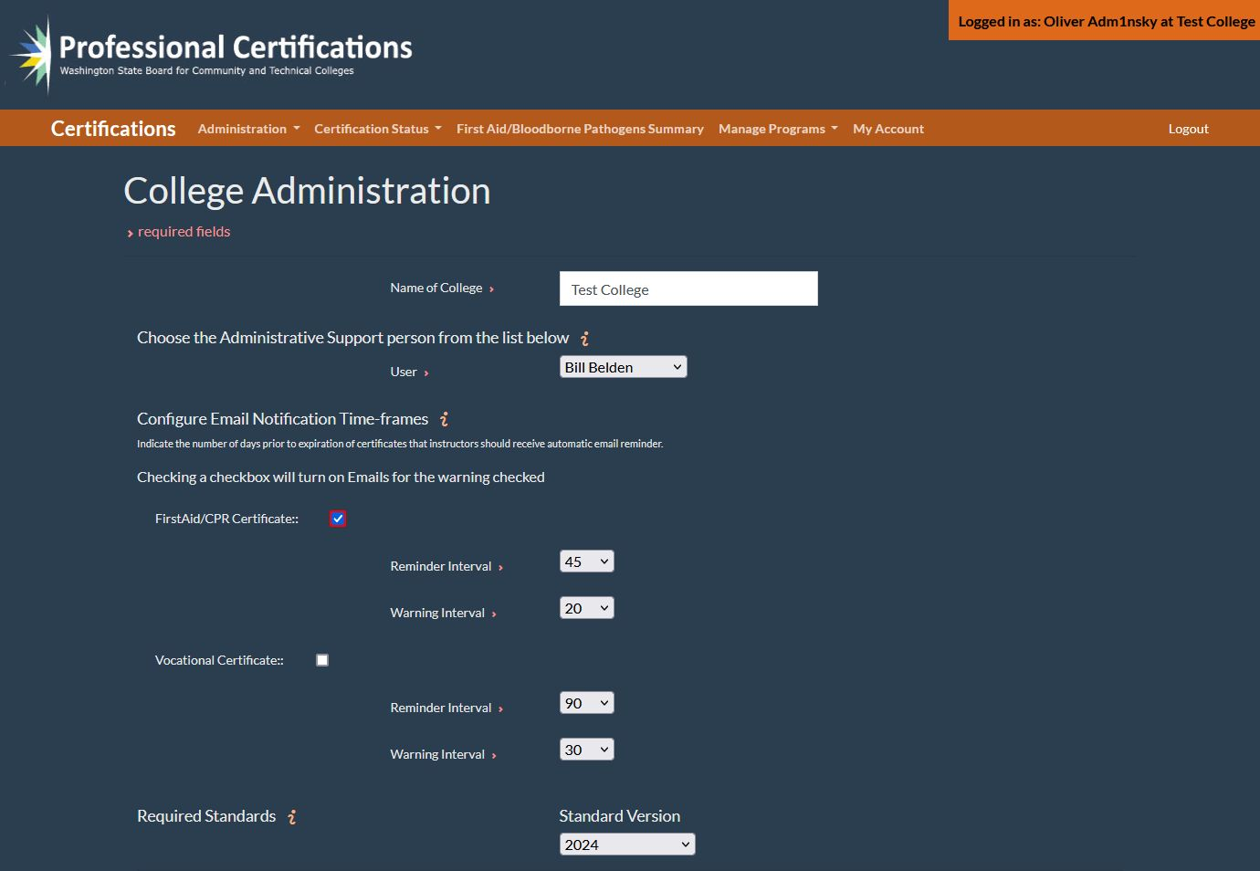
Notes:
Administrator/Administrator Assistant

Slide 17
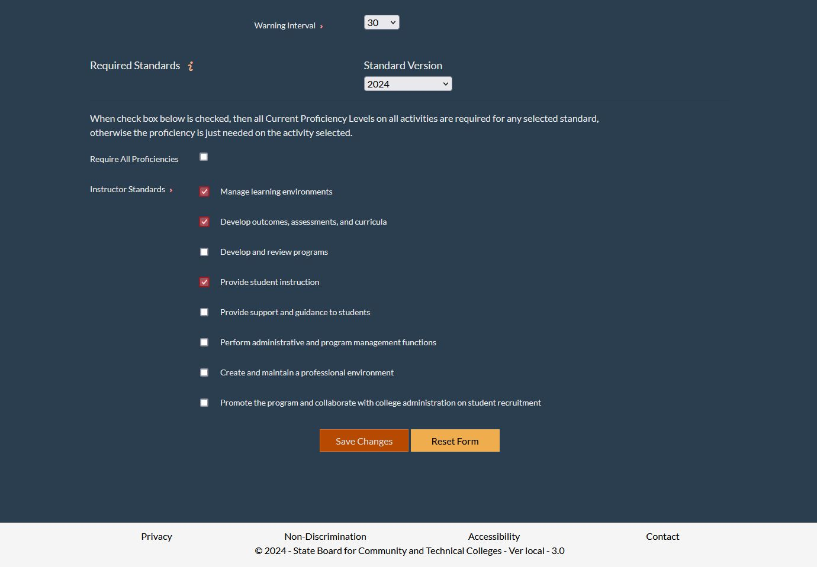
Notes:
Administrator/Administrator Assistant

Slide 18
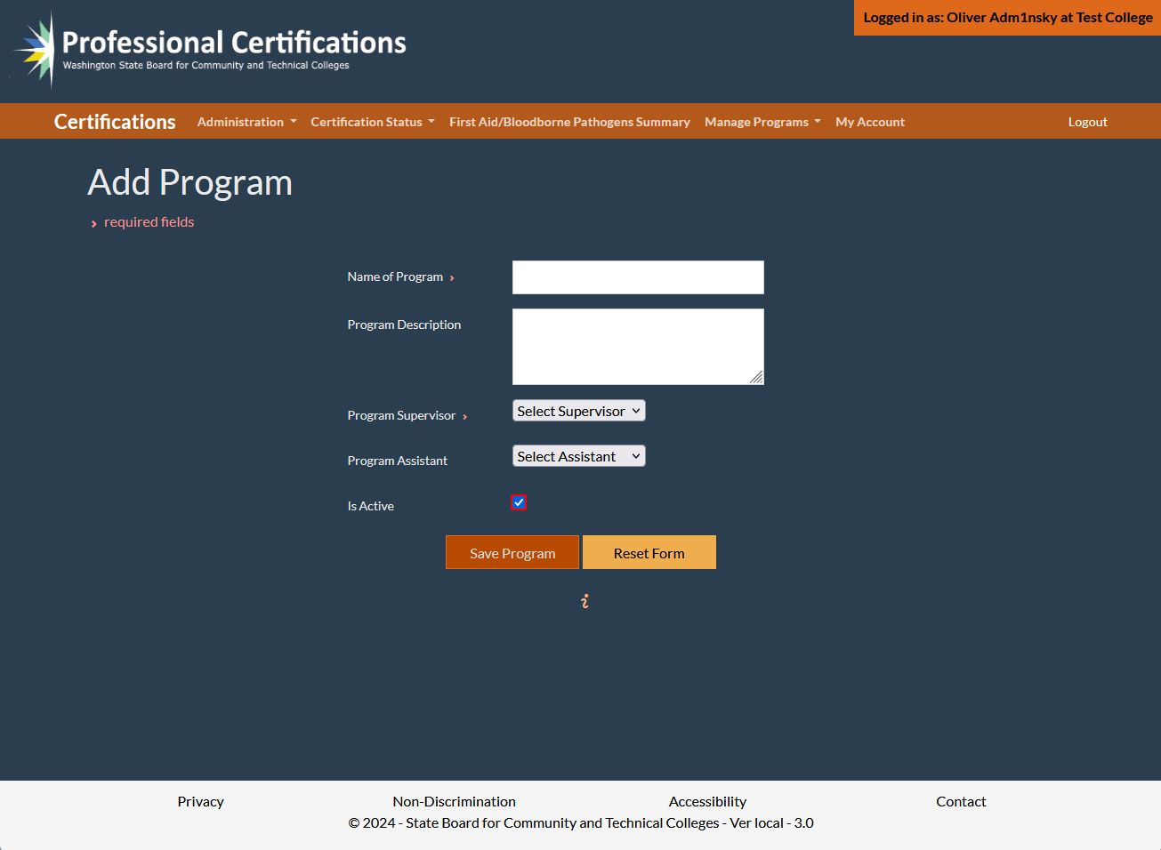
Notes:
Administrator & Assistant/Supervisor & Assistant

Slide 19
Notes:
Administrator & Assistant/Supervisor & Assistant

Slide 20
Notes:
Administrator & Assistant/Supervisor & Assistant

Slide 21
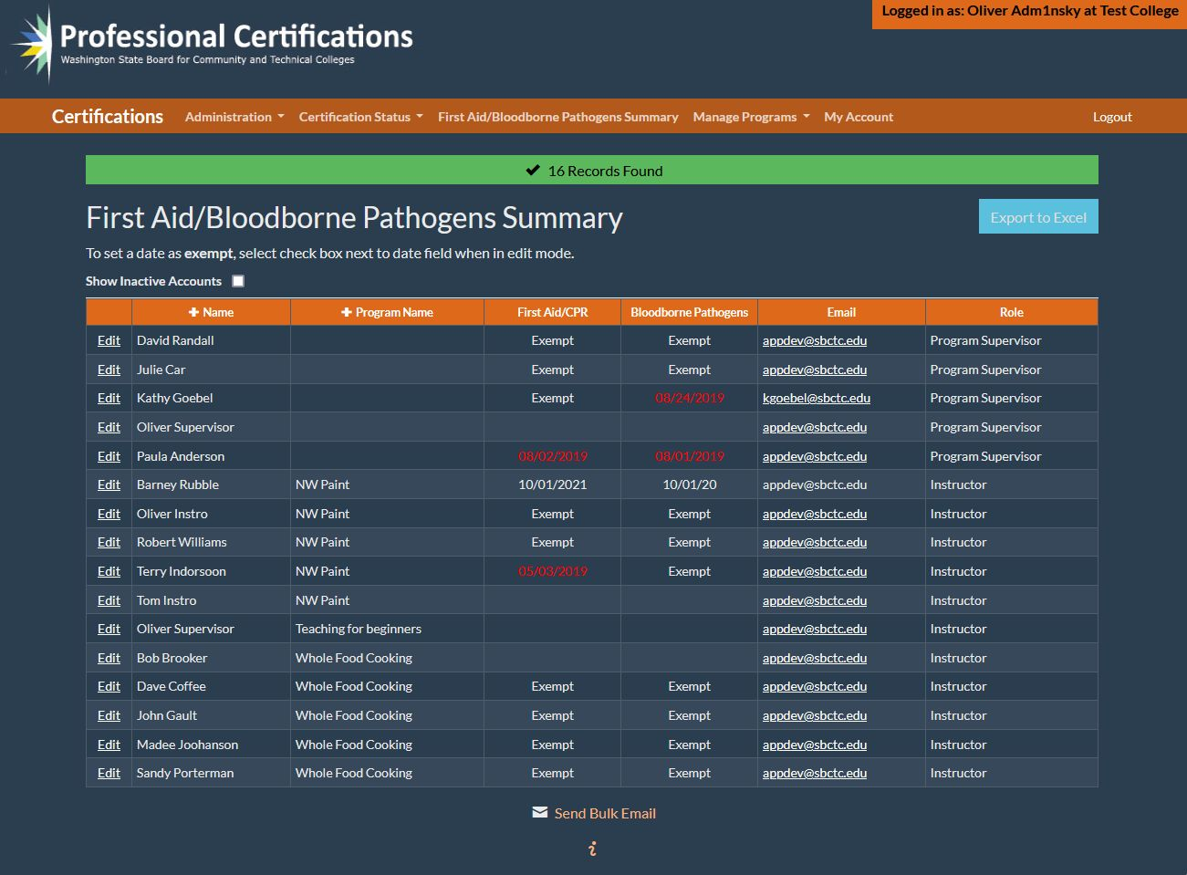
Notes:
Administrator & Assistant/Supervisor & Assistant

Slide 22
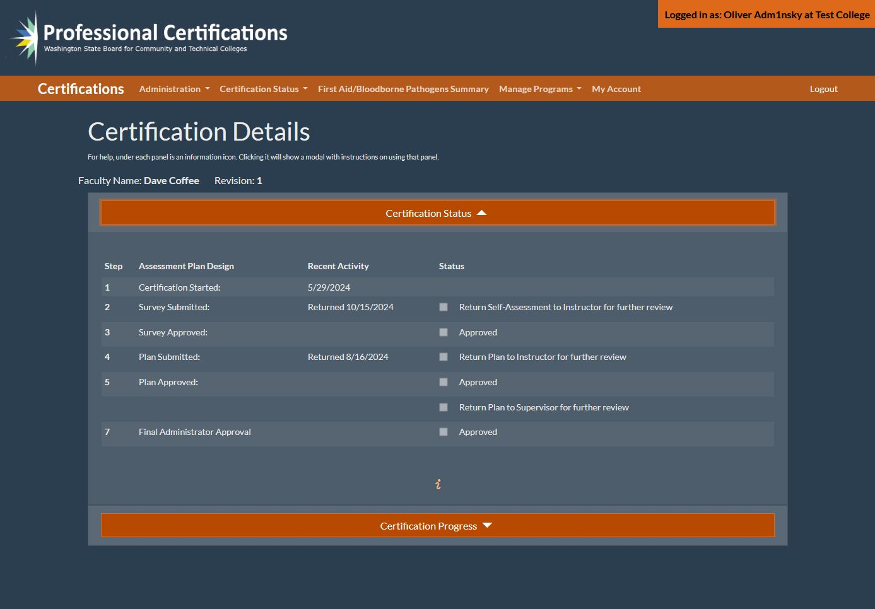
Notes:
Administrator & Assistant/Supervisor & Assistant/Faculty

Slide 23
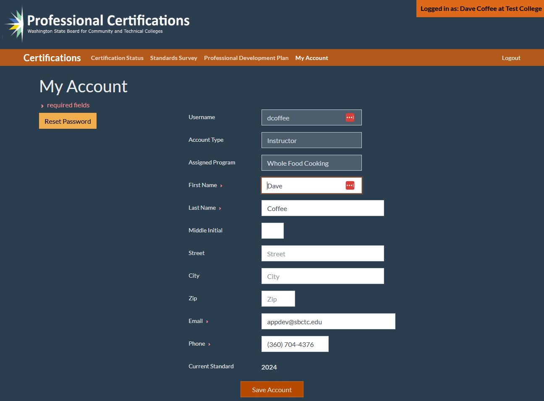
Notes:
Administrator & Assistant/Supervisor & Assistant/Faculty

Slide 24
Notes:
Faculty

Slide 25
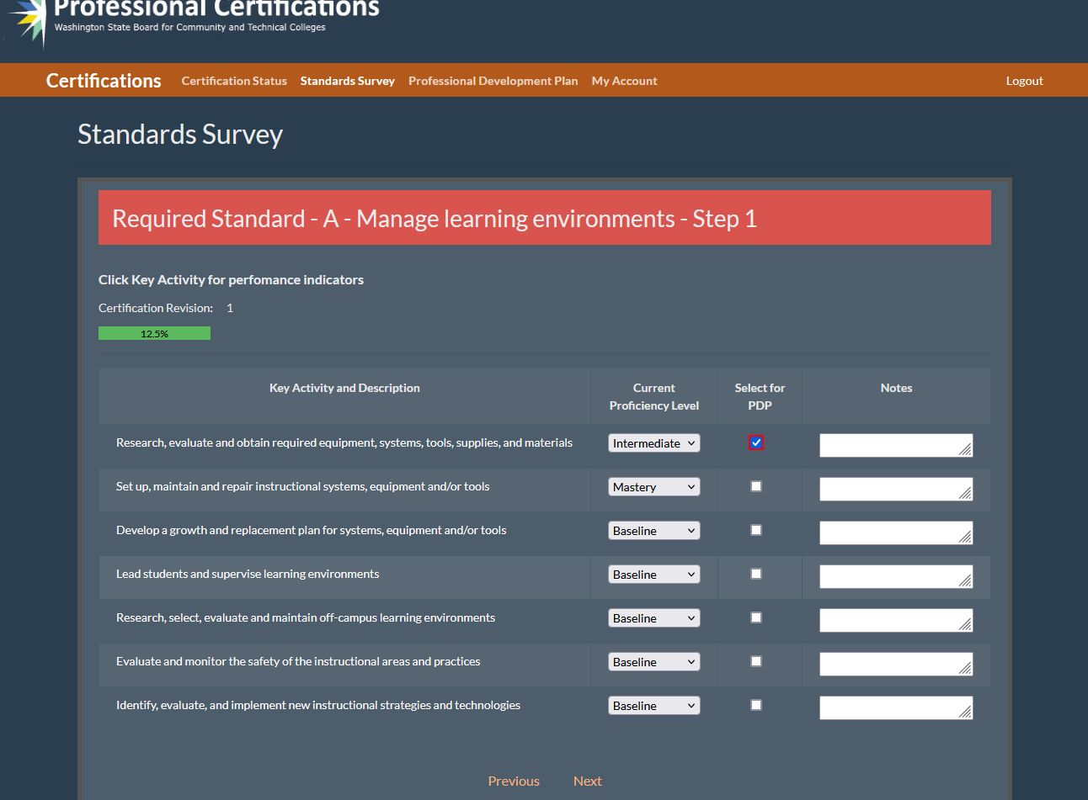
Notes:
Faculty

Slide 26
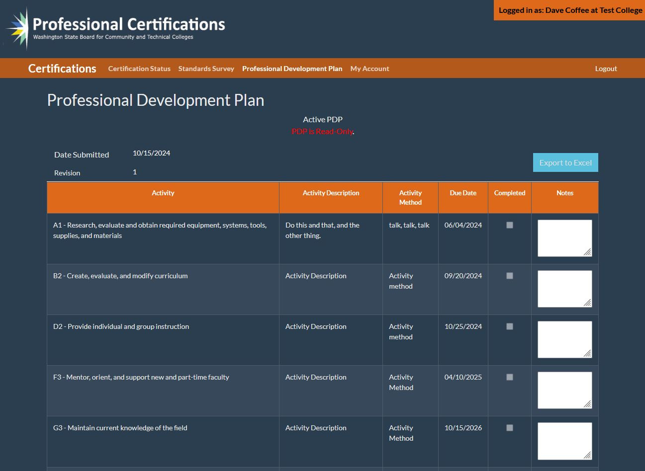
Notes:
Administrator & Assistant/Supervisor & Assistant/Faculty

