Slide 1
Integrating BEdA into Guided Pathways
A Path to Student Success
Alicia Peebles
July 23rd, 2024

Slide 2
Introduction
Who I am
Alicia Peebles (She/Her), Tacoma Community College Adjunct Faculty
Former Navigator for BEdA
Guided Pathways Workgroup Member

Slide 3
Before we start...
Where are your institutions at with Guided Pathways?
What does support for adult learners look like currently?
What did/does implementation look like?
How are your students doing with the changes?

Slide 4
Part 1: A brief overview of Guided Pathways at TCC

Slide 5
What is Guided Pathways?
Pathway Design
Pathway Development
Program Maps
Pathway Entry
Intake
Entry Advising
Pathway Navigation
Progress Monitoring
Teaching & Learning
Engagement
Scheduling
Completion Support
Degree Math and English in One Year
Effectiveness
Improvement
Inclusion
Alignment
Educational Planning
Financial Planning
Math Pathways
From the State Board of Community and Technical Colleges:
Guided Pathways is a research-based framework that simplifies choices for students. Courses are grouped together to form clear paths through college and into careers, whether students enter those careers directly after graduation or transfer to a university for more study in their chosen fields.

Slide 6
...but isn't that what we do already?
It should be
No surprises and ease of access to clear information
Degree worksheets easily available on websites or in advising office
Clearly shows what the degree requirements are and how to meet them
Wasn't always so easy to find that information

Slide 7
Pre-Guided Pathways Advising
An observation of Medical Scribe and the Math Pathway

Slide 8
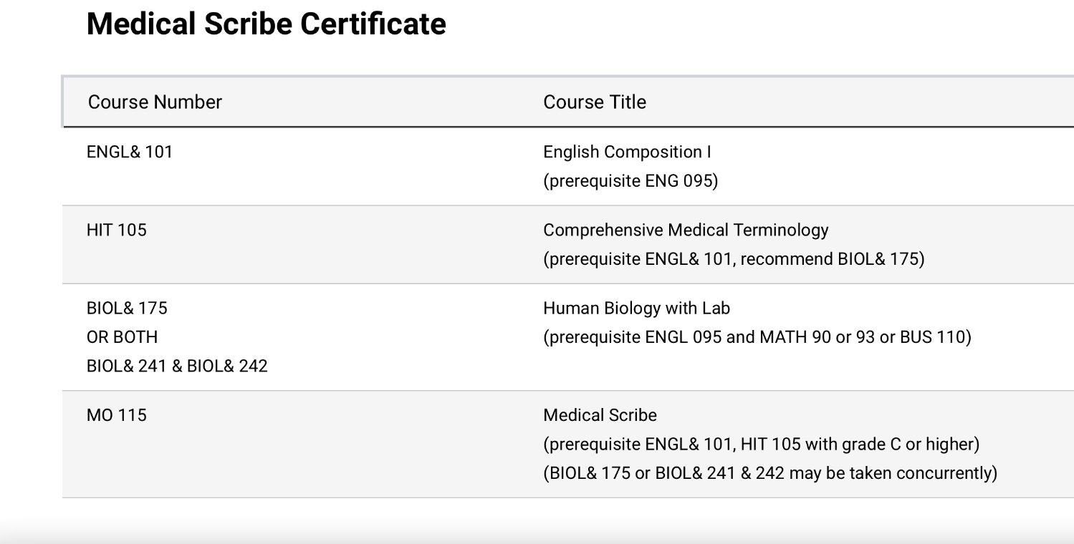
Medical Scribe Template

Slide 9
TCC Math DEPT Courses

Slide 10
TCC Math Sequence

Slide 11
Guided Pathways sought to simplify the process
Get students on the path and to completion sooner, while increasing retention and success

Slide 12
Where Guided Pathways Started at TCC
Started at TCC in 2017
Began with Pillars and Workgroups
Pillar teams were named after the four pillars (Mapping, Choosing and Entering, Keeping students on the Path, Ensure Learning), and a fifth team (Metrics and Tools)
Campus wide participation
Evaluation of programs, the advising model, the first-year experience, the intake process...literally everything!

Slide 13
Guided Pathways @ Tacoma Community College (Now)
Over time, shifted from Pillars to Guiding Team
Pillars were great to get community involvement, but they lacked ability to make decisions
Guiding Team includes dean team, Institutional Research, and faculty
Action Teams change depending on focus

Slide 14
Part II: Guided Pathways in the context of Adult Learners

Slide 15
Guided Pathways: The three big changes that relate to Adult Learners
Revising the Advising Model
Math and English Self-placement
College 101: College Success

Slide 16
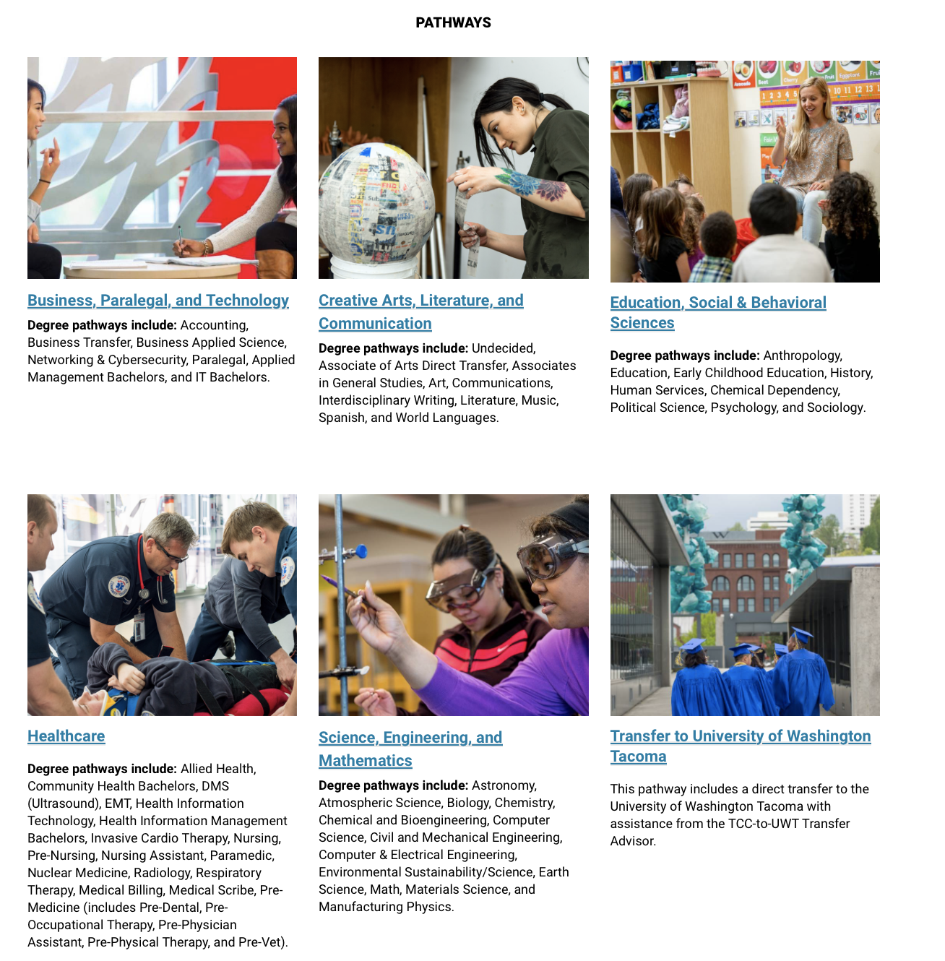
Revising the Advising Model
Grouped programs into career clusters and assigned advisors based on the clusters
Reduced advising loads from 500-600 to 200-300
Students work with same advisor for entirety of their degree program
Before enrolling for first quarter
Mandatory advising up to 30 credits
Must maintain 2.0 GPA

Slide 17
Math and English Directed Self-Placements
From Katie Gulliford, Dean of Institutional Effectiveness
Moved to DSP model for English in 2020, Math DSP debuted in Fall 2022
Math & 141 (Pre-Calculus) Completions increased 50%
Latino/a/x student completion of Math 141 tripled
African American student completion doubled
Multi-racial student completion of Math 141 increased 127%
With DSP, English placement at college level increased 69% to 72% and Math increased from 31% to 84%

Slide 18
College 101: College Success
College 101 became required for all transfer students and is highly recommended for Professional Technical students as well
Winter 2023 approval, Fall 2023 debut
87.6% of students who took College 101 in Fall '23 persisted to Winter '24
90.2% of students in Learning Communities containing College 101 persisted

Slide 19
How these changes help Adult Learners
Advising Changes
Less confusion regarding advisor changing
Prior: BEdA Navigator, to Advisor for a few quarters, to Faculty Advisor
Now: BEdA Navigator to Advisor
Math and English Self-Placement
Students have more input in their education
Can play it safe or try to challenge themselves
Allows them to learn about resources on campus, problem solving
College 101: Student Success
Allows BEdA students with knowledge of campus to share that knowledge with classmates
Builds confidence and allows them to see themselves as part of the campus community
A place to ask questions without the stigma of "you should know this already"

Slide 20
So where does BEdA Fit in Guided Pathways?
"It's the entry point for all the pathways!"
Well, yeah, but what does that mean?
BEdA allows students to "get on the path" early by introducing them to the expectations college will have for them

Slide 21
Part III: Adult Learners in College 101

Slide 22
A day in the life of Alicia's College 101 class
A great class to take in the last quarter in/first quarter out of BEda
Focus on skills that will help students beyond College 101
Including self-advocacy, study skills and time management, exploration of availability of careers, campus resources
Allow students to exchange knowledge with classmates
BEdA students with vast array of experiences share with classmates and build confidence
Topics include Gratitude/Vent Journals, Pro-Social Competencies, Procrastination and Time Management, How To Write A Professional Email,

Slide 23
Lesson Example 1: Financial Literacy Lesson
Introduced in Week 8
Discussion about creating a spending plan instead of a budget
Conversation turned to checking credit score, how to build credit, and lessons learned
Students shared hard learned lessons; older students gave advice to younger students of things to start working on now

Slide 24
Lesson Example 2: The hidden curriculum
Introduced in Week 3
Definition: the unofficial expectations, behaviors, and norms that students are expected to know when they step on campus
Examples include knowing about office hours, knowing how to communicate with teachers
The Hidden Curriculum is an insidious confidence killer in adult learners

Slide 25
Main focus in my classes: Fill in the Gaps
Many students (not just BEdA) have questions that they don't know where to ask or feel embarrassed about asking
Some examples of questions I get in the first week
"Where is the library?"
"Is there a gym?"
"How do I get an ID Card?"
"How do I see my schedule?"
"Did I actually get Financial Aid?"
"Can I get a laptop from the school?"
"How do I access my student email?' (Followed by, "I have a student email?")

Slide 26
Differences in teaching adult learners
Find ways to teach with them, not to them
Discussions in classes are enriched
They are remarkable resources for information about the community
Discussions around time management, grit, and financial aid
Some ask if college is even for them
Lots of community and confidence building
Conversations about availability and location of jobs
Pay is a huge issue
Generative AI discussion

Slide 27
You've heard from me, Now it's your turn!
What is working well at your institution?
Are there ways that you can integrate the stuff I teach into BEdA classes? Are you already doing it?
What are skills that you think BEdA Learners need in that first quarter after they finish ABE classes?
What topics would you add to a College Success class that would benefit Adult Learners?

Slide 28
Other Integration Ideas?
How would you like to see BEdA represented in Guided Pathways?
How can the State Board support BEdA staff and faculty to make Guided Pathways implementation smoother for our students?

Slide 29
Takeaways
BEdA is the entry point for any of the pathways
BEdA students make class conversations richer and more vibrant
Guided Pathways allows BEdA students to get into their programs sooner and can offer more support for them to make the transition out of our programs smoother
It is easy to feel disconnected from the process of implementing Guided Pathways as BEdA staff and faculty

Slide 30
Questions?

Slide 31
Thank you!

