Slide 1
Washington’s Community and technical colleges
SBCTC Spring 2024 WEC Update

Slide 2
SBCTC Spring Update
Friday, May 10
Agenda Topics:
System Updates
Project & Program Updates
Funding Updates
Staff and Resource Updates

Slide 3
Gainful Employment update
Summer Kenesson, Director of Policy Research

Slide 4
Legislative, program & Funding updates

Slide 5
Industry Demand (Carolyn)
Industry Demand: Meets the needs of industries, employers, and incumbent workers.
Team Members: Carolyn McKinnon, Danny Marshall, and Vicky Chungtuyco
Team Projects:
Incumbent worker strategies, micro-credentials, non-credit credentials
Ed Design Lab Micro-pathways Community College Growth Lab (collaborator)
Law enforcement & corrections workforce needs assessment (2023 Legislature)
Firefighter/Fire Sciences/Emergency Services Training & Education Committee
Homeland Security/Emergency Services COE, State Fire Marshal's Office, large group of fire chiefs and leaders
NEW: Retail Industry Workforce Work Group (proviso, 2025 report)
Customized Training Program tax preference audit by the legislature (reports July-Sept 2024)
Programs:
Job Skills Program (JSP) Customized Training (CTP) | Commercial Drivers Licensing Fund/Grant (aka "WA CDL Fund/Grant")
Workforce Development Funds | Invest in Washington
Centers of Excellence | Continuing Education Council (CEC)
Business (AWBI) & Labor (WSLC) Liaisons | Economic Development

Slide 6
funding Updates
Job Skills Program
Grant to be released in OGMS on March 28, 2024
FY25 Round 1 proposals due May 2, 2024
Commercial Drivers Licensing Fund (for CTCs)/Grant (for Private Career Schools/Colleges)
All funding is focused on expansion of CDL training capacity in the State of Washington
CTC grants were awarded through competitive application for development of CDL expansion over three years. Based on FY24 expenditures we were able to support for two additional CTCs for a total of 10. Planning for FY25 allocations are underway.
PCS/C grants are awarded through a competitive annual application. This grant was released in OGMS on March 24th and due April 25.
Workforce Development Funds
14 proposals were submitted by colleges by the April 4 deadline. Proposals are under review for projects to begin on July 1, 2024.
2 proposals meet new "Invest in Washington" funding criteria supporting manufacturing & production occupations.

Slide 7
Program Updates
Centers of Excellence Site Reviews
Thank you to our site review volunteers from WEC Executive Committee and WEC members at large!
We have the volunteers we need for the year, and welcome others to identify themselves to us if interested in being on the review committee in 2025.
The virtual site visit with Semiconductors & Electronic Manufacturing Center of Excellence was completed on April 29.
Site Visits coming up:
Construction Center of Excellence, May 13.
Cybersecurity Center of Excellence, November 14.

Slide 8
Program support (Bill)
Program Support: Provide overarching program support to strengthen business, industry and colleges.
Team Members:
William Belden
Kimberly Ingram
Shelby Means (Education Division)
Programs:
Carl D. Perkins | CTE Dual Credit
Comprehensive Local Needs Assessment (CLNA) | High Demand Grant
Program Approval Review & Program Inventory | Workforce Education Council (WEC)
Prof-Tech Certification | Customer Advisory Committee (CAC)

Slide 9
Perkins updates
CLNA
Highlights/Needs Document (email)
Advocacy
Survey and Interview Questions Solicitation
GRANTS
Perkins Plan
Revisions Due—May 21
Perkins Leadership Grants (Corrections, Non-Trad, LBG, Special Projects)
Feedback available—May 28
Revisions Due—June 6
Perkins Special Project—TBA
Perkins Non-Trad—(After priority deadline)-TBA

Slide 10
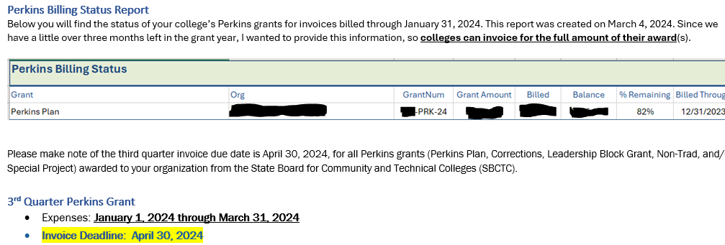
Grant Award/Invoices
Notes:
Do you have access to see available balance on your college's Perkins Grants? Yes No
How often do you review it?
Weekly
Monthly
Quarterly
During 4th Quarter
I don't
Did you receive the email notification of your college's Perkins Billing Status in March? Yes No
Was it useful? Yes No
Is your college having challenges spending grant awards?
If so, why?
Is your college having challenges invoicing grant awards?
If so, why?

Slide 11
technical assistance
ctcLink Workforce Reports (email)
Perkins Monitoring and Risk Assessment Webinar (May 30, 2-3pm)
Perkins Grant Approval Process Webinar (Perkins Plan/Perkins Webinars)
Monthly Virtual Office
Non-Trad Project Book
Uniform Grant Guidance and EDGAR Changes Training (TBA)

Slide 12
Program Approval Updates
New PAR site has launched
Online tool used to replace the existing google forms/links.
Reach out to programapproval@sbctc.edu with questions or access issues.
Ongoing enhancements to the site: feedback is appreciated and will be collected.
PAR Requirements
Advisory Committee Requirements
Equal representation of business and labor
Submit advisory committee membership form for new plan approvals.
Program inventory clean up
Continue working with colleges on inventory alignment as well as program status updates – moving plans to inactive status.
Apply the Common Attribute Framework values to inventory that will identify collaborations, special program funding, etc.
Resources Located at:
https://www.sbctc.edu/colleges-staff/programs-services/professional-technical/default.aspx

Slide 13
Sector Response (Anna)
Sector Response: Support colleges as they deliver career and sector-based educational opportunities to students
Team Members:
Anna Nikolaeva
Shanna McBride
Megan Harper
Programs:
Hospital Employees Education & Training (HEET) | Nursing Expansion
Early Achievers Grant (EAG) | Early Learning/Parenting Education
Worker Retraining (WRT) | Cybersecurity
 | Allied Health

Slide 14
Funding & Program Updates
Worker Retraining
Implementation of new base funding allocation
Early Achievers Grant
Demand update:
737 FTEs requested, comparable to FY24.
FY24 568 total FTEs were awarded.
No exact $ amounts available from DCYF yet for FY25 awards.
Staffing proviso: $2.4M requested, $801K received
Each of the 27 colleges will receive $25K, $126K remaining will be pro-rated according to longest waitlists, per proviso directive
Hospital Employee Education and Training (HEET) Grant
$1,997,232 available
8 applications totaling $2,629,342 in requests, $632K more than available funding amount
12 colleges engaged (3 consortia)

Slide 15
Work-based Learning (Genevieve)
Work-based Learning: Assist colleges as they provide experiential learning opportunities.
Team Members:
Genevieve Howard
Karin Gitchel
Programs:
Aerospace 1,000 FTE | Career Connect WA
Aerospace Apprenticeship FTE | Apprenticeship
Aerospace Contract | Aerospace Pipeline Committee
Career Launch Equipment & FTE | Aerospace Legislation
Career Launch Endorsement | Aviation & Aerospace Advisory Committee

Slide 16
funding Updates
Apprenticeship
$200K one-time funding to increase access and capacity to manufacturing apprenticeship related supplemental instruction.
Funding survey will be sent out to colleges with existing manufacturing apprenticeship programs.
Career Launch Capital Equipment
Available Round #2 Funding = $1,024,838
19 Program Applications from 9 colleges with funding requests totaling $2,229,757.
9 programs awarded funding from 6 colleges for a total of $1,001,179

Slide 17
Workforce contacts
Department Leadership
Marie Bruin, Director; mbruin@sbctc.edu
Kimberly (Kim) Wheeler, Workforce Assistant; kwheeler@sbctc.edu
Industry Demand: Meets the needs of employers and related partners across industries
Carolyn McKinnon, Policy Associate; cmckinnon@sbctc.edu
Danny Marshall, Program Administrator; dmarshall@sbctc.edu
Vicky Chungtuyco, Education Program Coordinator; vchungtuyco@sbctc.edu
Program Support: Provide support to strengthen business, industry and colleges.
William (Bill) Belden, Policy Associate; wbelden@sbctc.edu
Kimberly Ingram, Program Administrator; kingram@sbctc.edu
Shelby Means, Program Inventory Coordinator; smeans@sbctc.edu
Sector Response: Support delivery of career and sector-based educational opportunities.
Anna Nikolaeva, Policy Associate; anikolaeva@sbctc.edu
Megan Harper, Program Administrator; mharper@sbctc.edu
Shanna McBride, Program Administrator; smcbride@sbctc.edu
Work-based Learning: Assist colleges as they provide experiential learning opportunities.
Genevieve Howard, Policy Associate; ghoward@sbctc.edu
Karin Gitchel, Program Administrator; kgitchel@sbctc.edu

