Slide 1
AWB Institute
Workforce Education Council
May 9, 2024

Slide 2
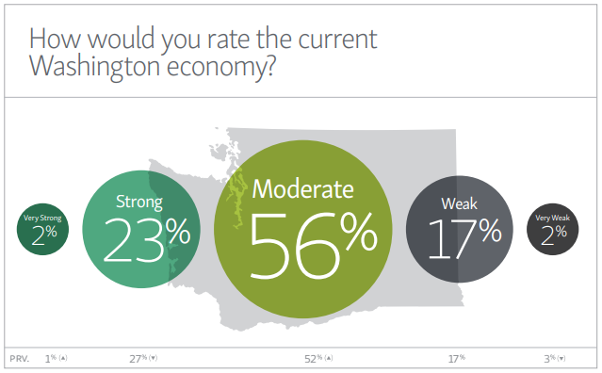
How would you rate the current Washington economy?
Notes:
AWB’s winter 2024 employer survey finds more optimism among the businesses of Washington, with half anticipating growth in the next six months. Inflation – while lessening – is still an issue, however.

Slide 3
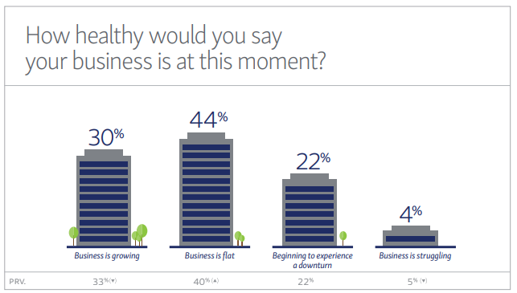
How healthy would say your business is at this moment?

Slide 4
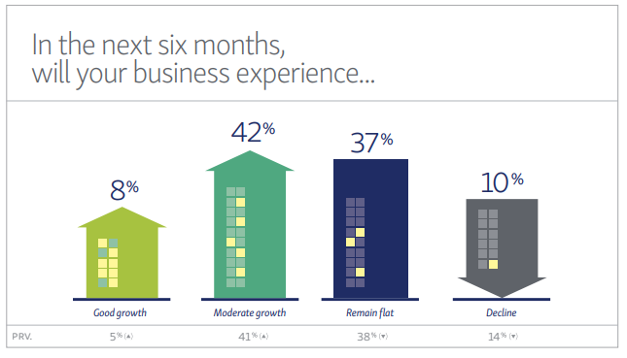
In the next 6 months, will your business experience ...

Slide 5
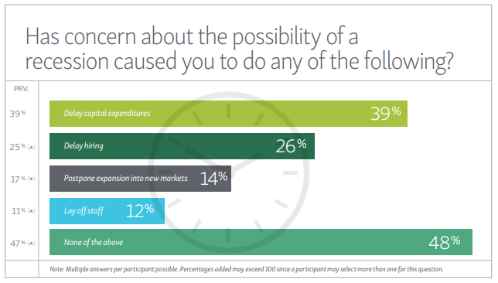
Has concern about the possibility of a recession caused you to do any of the following?

Slide 6
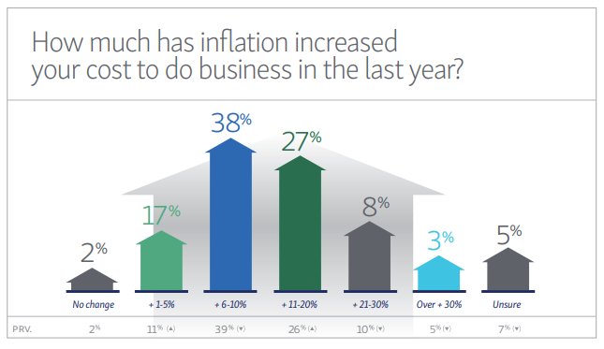
How much has inflation increased your cost to do business in the last year?

Slide 7
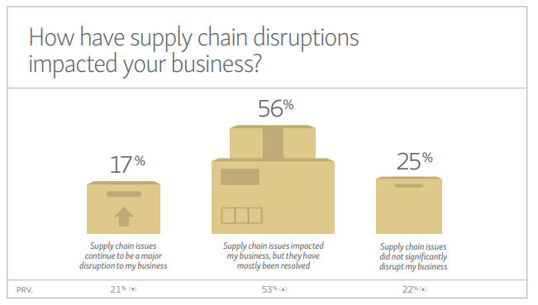
How have supply chain disruptions impacted your business?

Slide 8
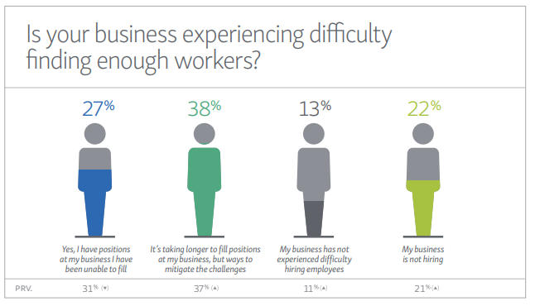
Is your business experiencing difficulty finding enough workers?

Slide 9
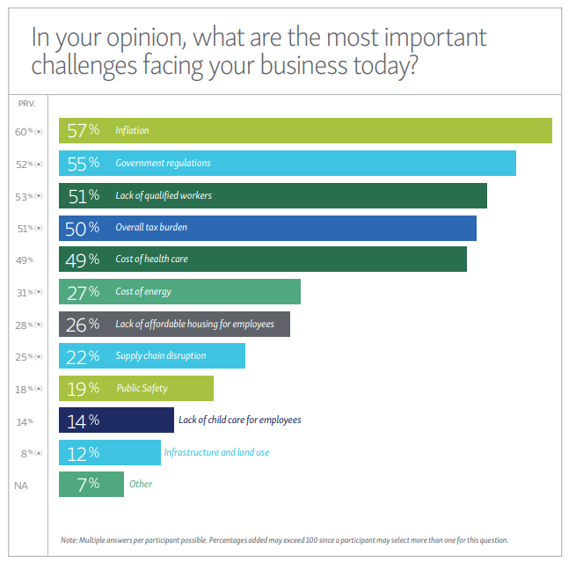
In your opinion, what are the most important challenges facing your business today?

Slide 10
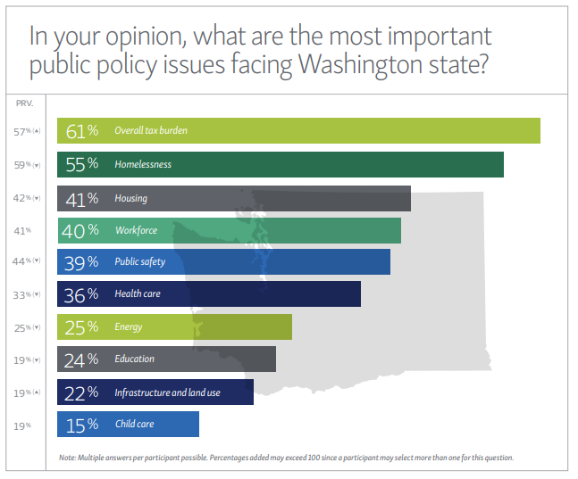
In your opinion, what are the most important public policy issues facing Washington state?

Slide 11
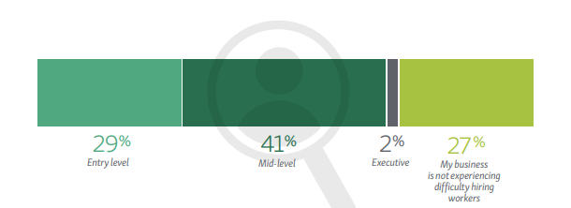
If you are experiencing difficulty hiring workers, at which skill level are you experiencing the most difficulty?

Slide 12
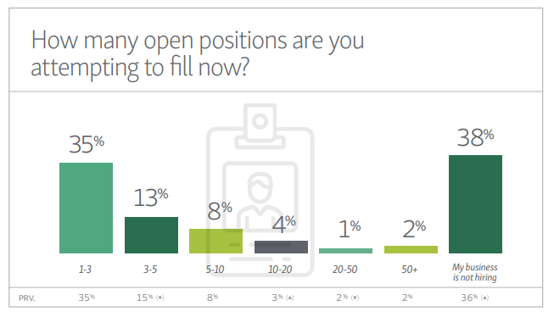
How many open positions are you attempting to fill now?

Slide 13
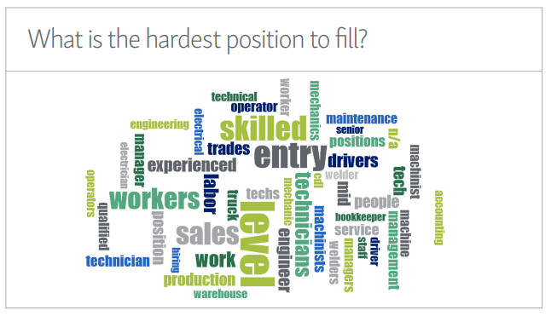
What is the hardest position to fill?

Slide 14
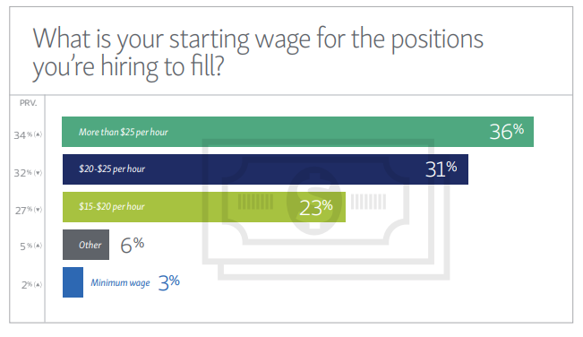
What is your starting wage for the positions you’re hiring to fill?

Slide 15
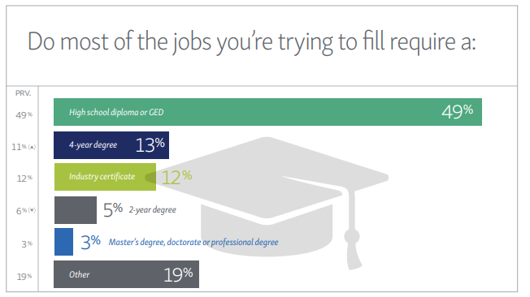
Do most of the jobs you're attempting to fill require a:

Slide 16
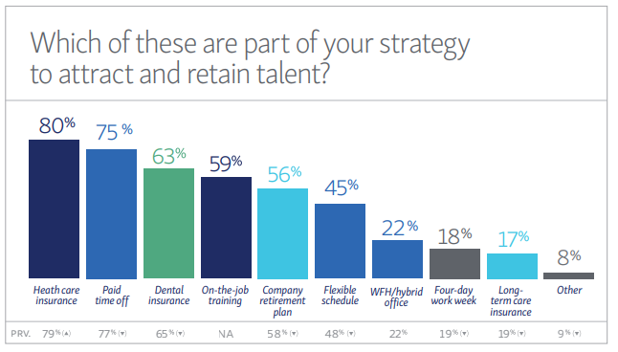
Which of these are part of your strategy to attract and retain talent?

Slide 17
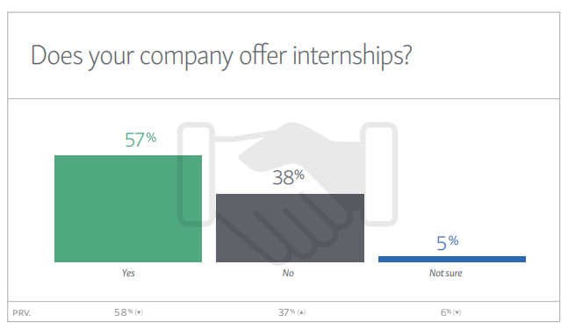
Does your company offer internships?

Slide 18
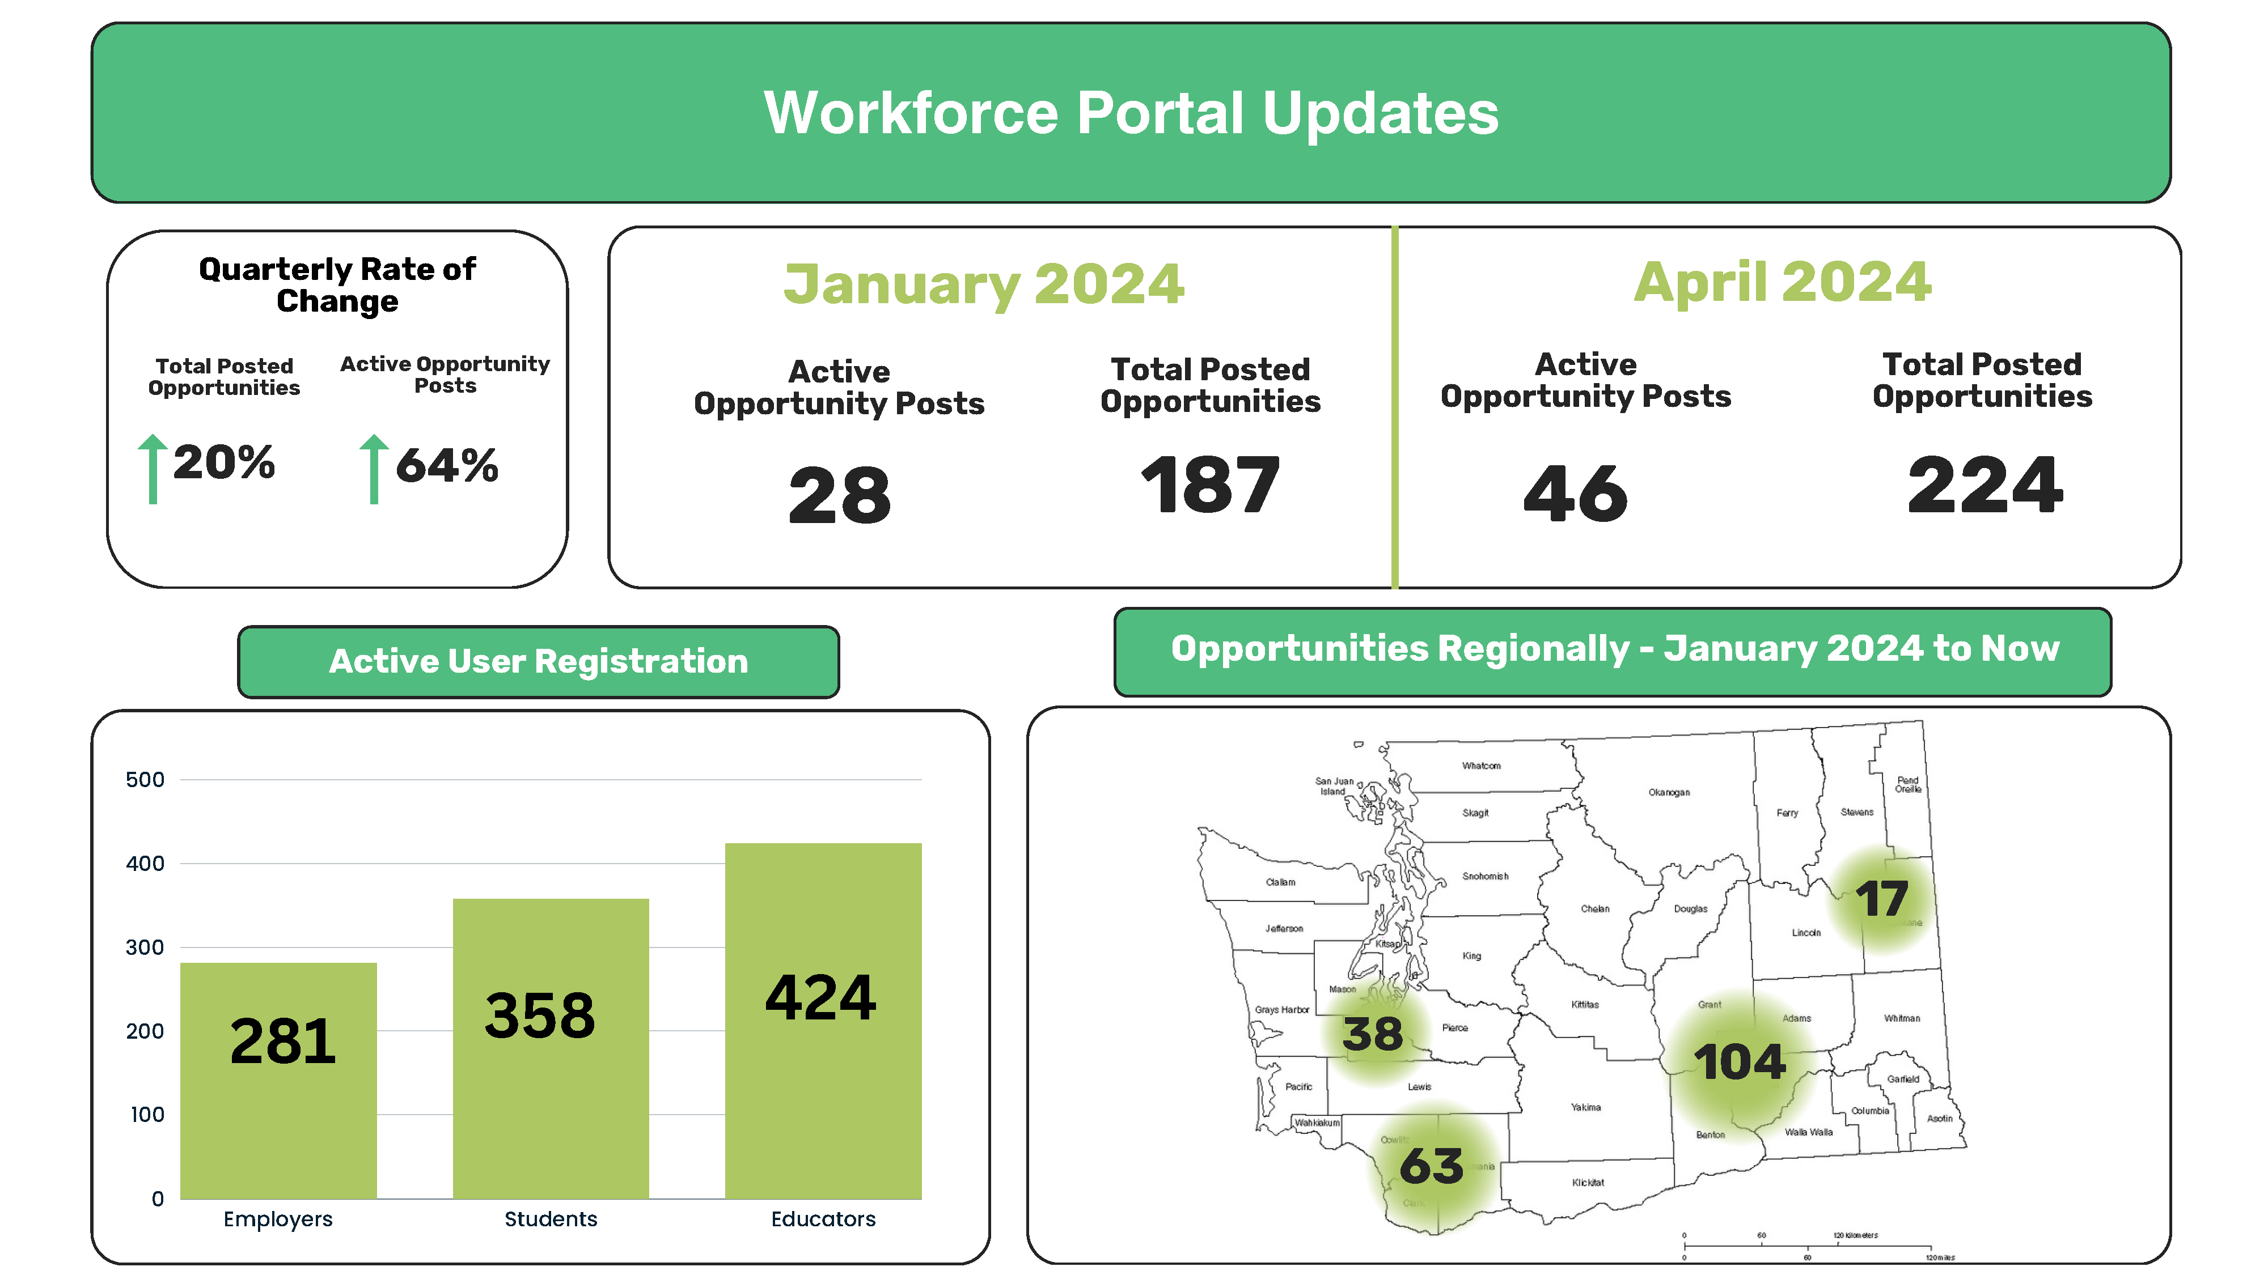
Washington Workforce Portal Updates

Slide 19
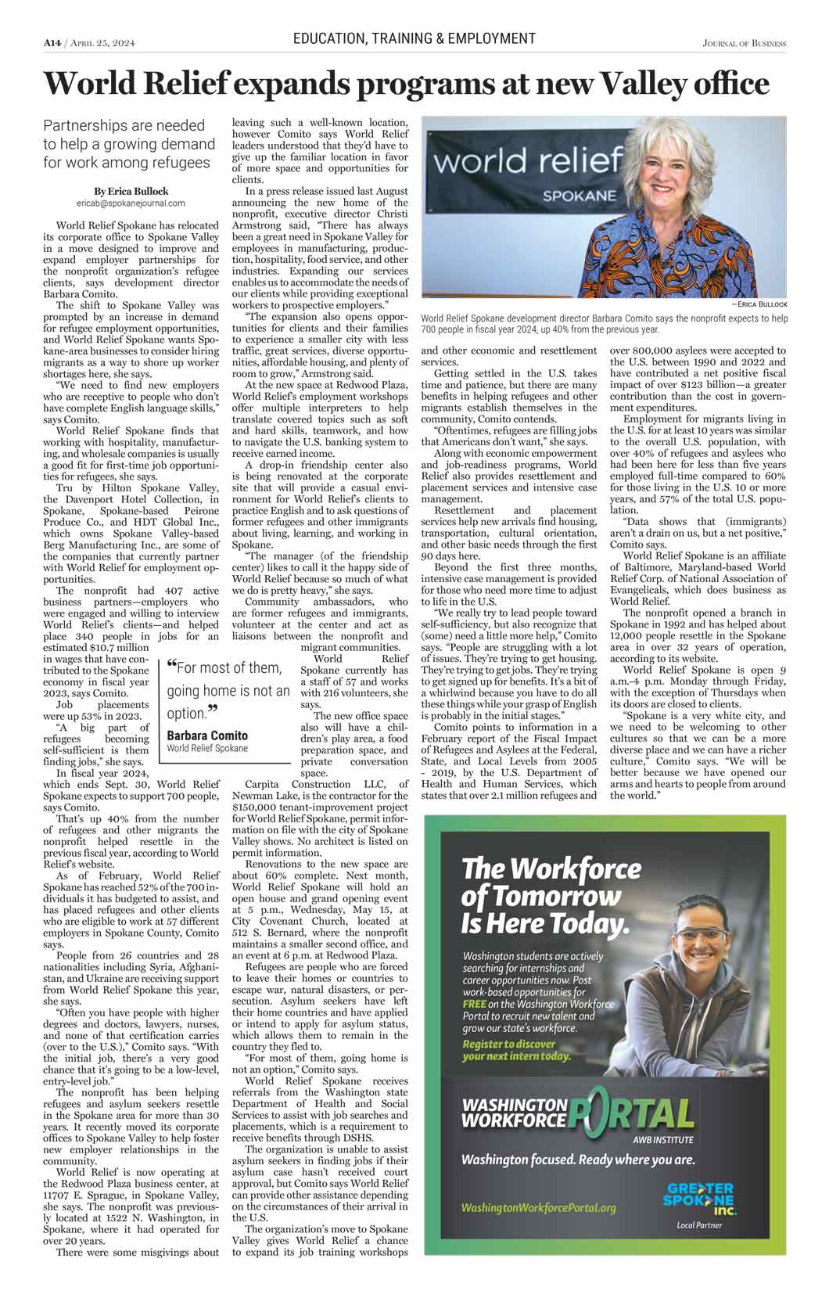
Washington Workforce Portal
Strategies for 2024 Internship Season
Advertising Campaign
Journals of Business
Spokane
Tri Cities

Slide 21
Community College Connections
Spokane Community College:
Jaclyn Jacot, Interim Vice President of Instruction
Jeff Williams, Acting Dean of Extended Learning & Workforce Initiatives
Professor John Norman, Hydraulic and Pneumatic Automation
Dr. Ashley Purdin, Dean of Technical Education
Spokane Falls Community College
Dr. Chris Pelchat, Dean of Professional Studies, Library, and Workforce Education
Tacoma Community College
Kelli Johnston, Director, Workforce Education
Adrienne Scarcella, Director of MESA
Mary Jane Oberhofer, Dean of Applied Science
Natalie Wilkerson, Career Center Coordinator
Sonja Morgan, Director of Student Engagement
Up Next...
Vancouver
Clark College
Lower Columbia
Notes:
During the February WEC Meeting, Samantha connected with Kelli Johnston and talked about making the Washington Workforce Portal TCC’s main resources for students to search for internships in Washington State. Following up on the conversation, in the month of March, Samantha met with Kelli and other TCC faculty/admin to discuss adaptation of the Washington Workforce Portal. After doing an overview of the site and capabilities, TCC expressed interest in moving forward with adoption and connecting with the Tacoma – Pierce Chamber of Commerce moving forward. After the meeting, Samantha followed up with TCC and sent over Workforce Portal resources. AWB Institute is currently in the processes of setting up a meeting with the Tacoma – Pierce Chamber and TCC to continue the discussion on implementation of the Washington Workforce Portal for the Tacoma region.

Slide 22
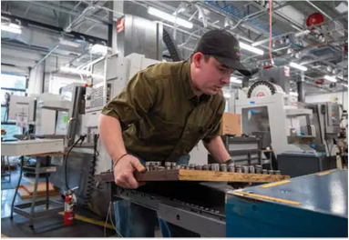
Building the Biomanufacturing Pipeline
Shoreline Community College partners with Industry leaders to prepare students for careers in the booming biomanufacturing sector.
“The program is helping us find people who have the aptitude to do work like this. It doesn’t necessarily take on extensive science background. It’s more a matter of ‘Can you pay attention to detail? Can you follow instructions? Can you work as part of a team? Can you learn quickly?’”
-JOSH LOPES, SENIOR MANUFACTURING MANAGER AT THE BRISTOL MYERS SQUIBB CELL THERAPY MANUFACTURING FACILITY IN BOTHELL

Slide 23
2024 Legislative Session – Top Bills
Financial Aid
SB 5904 – Expands state financial aid eligibility to six years or up to 150 percent of program length
SB 5953 – Allows incarcerated individuals to apply for federal and state financial aid grants for postsecondary education programs offered at Department of Corrections facilities
HB 1943 – Expands eligibility for the Washington National Guard Post Secondary Education Grant Program to spouses and dependents of Guard members
SB 6053 – Requires OSPI to share high school student directories with WSAC to increase awareness of financial aid and postsecondary opportunities
HB 2214 – Automatically qualifies beneficiaries of public assistance for the Washington College grant

Slide 25
