Slide 1
Equity-Driven Alternative Assessment for
Basic Skills Learners:
Life Beyond Standardized Tests
COABE National Conference
April 2, 2023
Notes:
Presentation time: 8:45 PST on Monday, April 3
Jennifer

Slide 2
The Team from Washington State
Jennifer Barber - South Puget Sound Community College
Curtis Bonney - North Seattle College
Will Durden - State Board for Community and Technical Colleges
Kim Flack - Tacoma Community College
Sherri Fujita - Spokane Community College
Cat Howell - Literacy Source
Notes:
Jennifer Intro During COVID-19, Washington State was shut down. This meant we could not CASAS test, which led to a number of innovations. Some of these had been in the works. Others were the result of having to find a new tool quickly. WA SBCTC has education councils, including the Council for Basic Skills. At the beginning of the pandemic, deans and directors met weekly. As these conversations evolved, we realized that our new approaches to placement and assessment were supporting our goal to bring equity to our work. As we move out of the pandemic, we want to continue this work.

Slide 3
Where Do You Work?
Respond to our poll in the Whova app.
Notes:
Poll in App - Cat to make

Slide 4
Turn & Talk
Close your eyes and think back on your educational journey.
Are you someone who tests well? Do you have “test anxiety?
Is there a standardized test in your history that had meaning or power? Reflect on that experience. What kind of reaction did you have?
Talk to someone near you or share your reflection in the chat.
Notes:
Turn and talk or drop reflections in the chat.
Jennifer B to lead. 5 minutes. Curtis will give a few examples from chat.

Slide 5
Agenda 11:45-1:00
Introductions and Goals for Presentation
State Board for Community and Technical Colleges (SBCTC) Overview/WIOA
Turn & Talk
Alternative Self Placement
Turn & Talk
Data & Practices
Rationale/Proposal
Q&A
Notes:
Jennifer to go over Agenda
Curtis will be timer - will send 1 minute warnings
11:30-11:45 Turn & Talk
11:45-12:00 Alternative Self Placement
12:00-12:15 Turn & Talk
12:15-12:30 Data
12:30-12:45 Rationale/Proposal
12:45-1:00 Q&A
11:30-11:45 Turn & Talk
11:45-12:00 Alternative Self Placement
12:00-12:15 Turn & Talk
12:15-12:30 Data
12:30-12:45 Rationale/Proposal
12:45-1:00 Q&A

Slide 6
Goals for Today
Review how standardized tests can work as a barrier
Show how Washington state providers use multiple measures to accurately place and assess students
Encourage a national move to alternative assessment models, funding, and systems
Notes:
Jennifer does this slide

Slide 7
Word Cloud
Think of a word that represents one of the challenges that standardized tests pose for practitioners and/or students.
Add your word to the word cloud.
Notes:
***Add Word Cloud (Cat) Sherri reviews this slide to transition to her part
This is a list brainstormed at CBS. Sherri takes over here. Ask audience to share out/chat what barriers they see. Do word cloud on polls
Monetary cost - test fees, personnel to administer, purchase and maintenance of technology
Other costs - loss of instructional time, assessment costs decrease budget for students
Over-reliance on technology
Length of test does not match the length of an academic hour
Disconnected from the curriculum
Problematic/racist test items
Inaccurate and limited information on student proficiency
Make a poll word cloud - Cat
Animation?

Slide 8
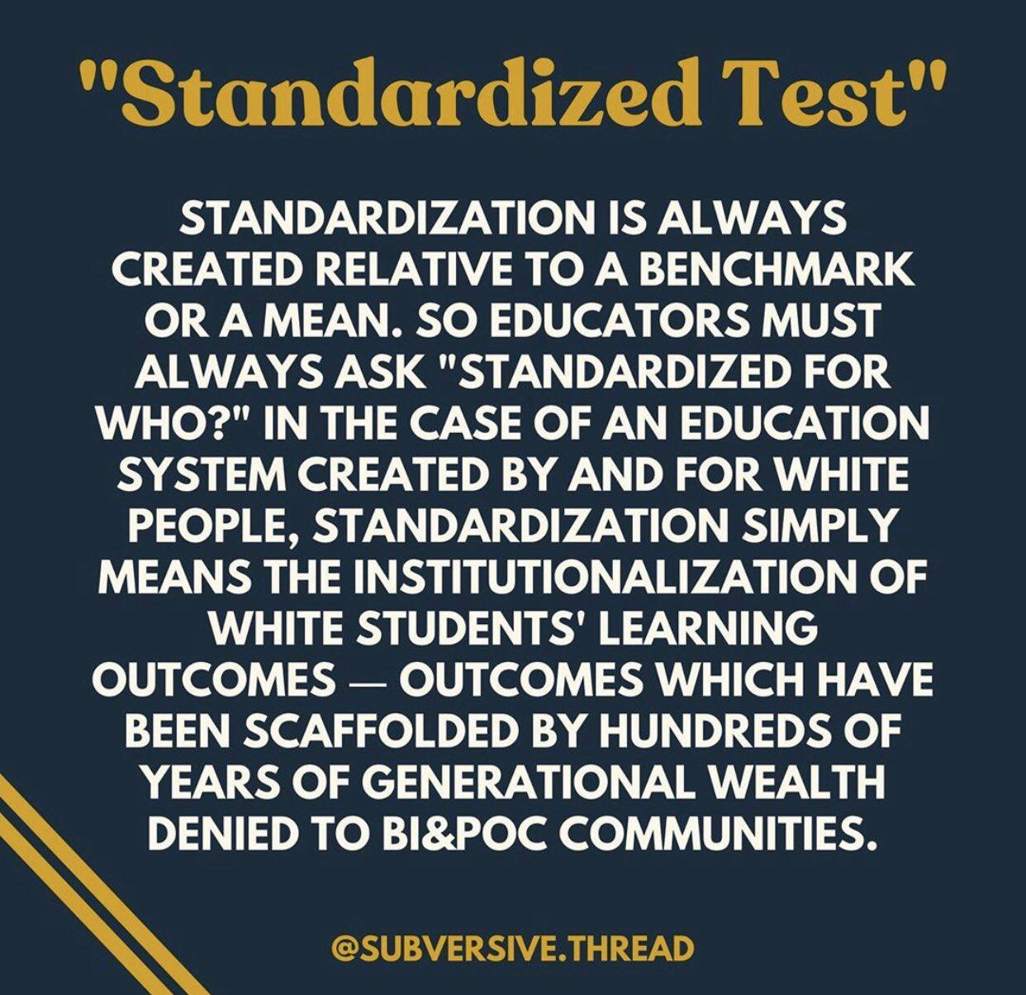
Notes:
Sherri talks through quote.

Slide 9
WA State Board (SBCTC) Vision
Leading with racial equity, our colleges maximize student potential and transform lives within a culture of belonging that advances racial, social, and economic justice in service to our diverse communities
BEdA Goal #1: Intentionally review, develop and implement culturally responsive policies and practices that promote racial and economic justice.
Notes:
Will steps in here -

Slide 10
Overview of Washington State System
Title II funds come to the community and technical college system (SBCTC), which funds all thirty-four colleges as well as five community-based organizations.
We use CASAS exclusively.
High School + does not require testing per OCTAE Program Memo 17-2.
Our I-BEST programs rely on MSG 3 (postsecondary transcript) in lieu of post-testing.
Notes:
Will: state-wide perspective

Slide 11
State Perspective
March 23, 2020 - State Lockdown
Almost two years remote with limited exceptions- local variations in how long and to what extent.
Providers embraced and experienced success with a variety of methods to place and assess students
We advocate for research pilots to explore these and other methods to place and advance students in addition to the test and within the performance accountability system already established by the law.
Notes:
Will:
Our Governor sent us all home March 23, 2020.
Programs were not allowed to be onsite, with limited exceptions, for nearly two years, with local variations in how long and to what extent.
How providers conducted initial intake, placement, and ongoing assessment without testing is at the heart of this presentation.
We advocate for research pilots to explore these and other methods to place and advance students in addition to the test and within the performance accountability system already established by the law.

Slide 12
Long Term Outcomes: Table 5 Summary
Core Follow-up Outcome Achievement | All Periods of Participation
 | 2018 | 2019 | 2020 | 2021
2nd Qtr Employment | 27% | 29% | 32% | 37%
4th Qtr Employment | 28% | 29% | 34% | 35%
2nd Qtr Median Earnings | $5,000 | $5,400 | $5,600 | $6,000
HS Credential & Transition | 12% | 11% | 12% | 11%
HS Credential & Employment | 23% | 24% | 25% | 22%
Postsecondary Credential | 63% | 63% | 83% | 82%
Any Credential | 54% | 53% | 63% | 59%
Notes:
WILL Point: pre to during to post pandemic: no big changes on long-term outcomes linked to suspended operations and no CASAS testing

Slide 13
Turn & Talk
How did you place students and measure gains during the pandemic/shutdown?
Did things change? How so? Did you continue with any of those changes?
Notes:
Cat
5 minutes. OPTIONAL? Curtis will check clock - depending on timing, do it or move forward?

Slide 14
Alternative Placements and Measurable Gains
Perspectives:
Literacy Source (CBO)
Spokane Community College
North Seattle College
Tacoma Community College
South Puget Sound Community College
Notes:
Cat speaks

Slide 15
Literacy Source
NRS aligned level completions for productive skills: Students demonstrate competencies for level through final projects
Ready to Work level ¾ final paragraph project: Project directions, scoring rubric
English for Community Connections (ESOL 4-6) Final Podcast project
NRS aligned writing test for placement and level completion demonstration
Basic writing assessment, Essay writing assessment, writing rubric
NRS aligned speaking test for placement and level completion demonstration
Speaking assessment & rubric
Notes:
Cat
Moving to section on what the WA providers did during the pandemic and I’m up first
Intro to Lit source: Cat takes
One of the CBOS federally-funded through SBCTC in WA state
Free classes and tutoring to adults - ABE, ESOL, Citizenship, Work Skills, GED prep & Digital Literacy
Over 600 students/year, 22 classes; 95% students are refugee or immigrant status, 46 languages spoken
Low intensity program (5-12 hours/week of classroom instruction)
Tutoring supports classroom-based instruction (3 hrs/week)
200 Instructional volunteers in class assistant and tutoring (70) roles
Other completion examples:
Other examples: lab report in GED science class, written biography/narrative in ESOL ⅘ class, dialog about a shopping receipt in ESOL 1 Literacy class)

Slide 16
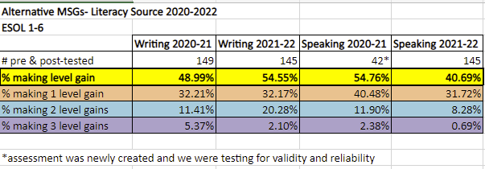
Literacy Source
Program Data during Pandemic alternative measures period from Literacy Source
Notes:
Cat
Main point: standards based productive measures: students demonstrated NRS-aligned level gains (without CASAS)

Slide 17
Literacy Source
Alternative goal attainments we track that are currently not counted - and should be!
Citizenship attainment
GED subtests, GED Ready tests
Workforce skills certificates (e.g. child care license, food handler’s permit)
Digital skills goals completions (system lacks aligned rubrics)
Notes:
Cat
Main point: students are demonstrating learning in ways that are meaningful to them but are not currently captured by federal reporting

Slide 18
Spokane Community College
Urban and suburban college - 13,300 students
Adult Education - 1,800 (ESL, HS+/GED, Pre-Apprenticeship, I-BEST, College Prep)
Regional Accreditation: Northwest Commission on Colleges and Universities
Guided Pathways Campus:
No prerequisites for most professional and technical programs
English: directed self-placement
Math: multiple measures
Adult Education on pathway maps
Adult Education Division:
Courses are approved by the campus Curriculum Committee.
Outcomes are aligned with NRS levels and Appendix B descriptors
Students are placed using writing samples, interviews, and directed self-placement
Faculty grade courses according to course outcomes
Notes:
Sherri

Slide 19
North Seattle College
Career and College Readiness Standards (CCRS)-aligned/NRS-aligned activities and assessments in ELA/ESL - using appendix B (NRS Level Descriptors for ABE/ESL).
Focus on productive skills - writing, communications, and digital literacy
Example – ESL 3
Questionnaire for student self-placement in I-BEST programs instead of using CASAS to determine eligibility.
Directed self-placement helps students to think about their academic backgrounds, their strengths and challenges, and their goals, as they begin an I-BEST career pathway.
Notes:
Curtis - I will give a very brief overview of BEDA at North, then a brief review of how things changed during pandemic, then pivot off Sherry’s broader view with a focused look at 2 specific innovations. I will need to be able to share my screen.

Slide 20
Tacoma Community College -
Participant Placement - Equity, Agency and Capacity
Placement
College-wide Directed Self Placement Reading/Writing - Intro ABE through ENGL& 101
BEdA specific Math Directed Self Placement
ELA Directed Self Placement - guided conversation with intake staff
Notes:
Kim
The seven elements contribute to learner agency: voice, choice, engagement, motivation, ownership, purpose, and self-efficacy.
Wide body of research that suggests that nurturing, building, and leveraging student agency has a significant and positive impact on academic achievement, retention, and persistence.

Slide 21
Tacoma Community College
Measurable Gains
ELA multiple measures -
Guided self-progress conferences and checklist- empowers students, promotes agency
Self-reflection paper - evidence-based process that requires critical analysis of progress - compared to outcomes and anchor examples - sample student reflection
Portfolio Checklist- Collection of work demonstrating outcomes met
Single Point Rubric - more intentional focus on feedback in each dimension, easier and more meaningful for students, especially English Language Learners
ABE multiple measures -
Standards-based final writing assessments and Rubrics
IBEST / College and Career Pathway Academy
Personal Statement - Standards-based Writing assignments and Rubrics
HS+ - Competency-based English Credit
Rubric
Portfolio Panel - Student Presentation
docs.google.com/document/d/1V9d-Tr7JgEYPTsBWWgwQZg80lyt11oAb/edit?usp=sharing&ouid=108829330398646631757&rtpof=true&sd=true
Notes:
Kim

Slide 22
Tacoma Community College
NRS Federally Reportable Measurable Skill Gains (MSG) - 11-35%
Federally reportable Students & challenges collecting data at intake - many students did not show in outcomes
Challenges with post testing, especially for ELA during remote operations
Alternative to MSG - Equitable and valid measures of student success
Aligns with institution-wide measures - Tableau dashboards managed by Institutional Research
Successful Course Completion - Grades
2018 to 2022 - Average 85% successful course completion
Retention
quarter to quarter 75 to 81%
fall to spring 56 to 69%
Notes:
Kim

Slide 23
South Puget Sound
Student Success Rates
Year | Pass Rate | Modality
2017-2019 | 82% | in person
2019-2021 | 76% | online
Notes:
Jennifer

Slide 24
Rationale for Multiple Measures
Equity
Accessibility
Contextualized/authentic to coursework
Improve cooperation with workplace partners and training providers
Facilitate large-scale fully remote learning
Notes:
Will: (check time here - if little time, just show word cloud, if not, can get more questions from the audience)
Summary: we’ve hit on a lot of reasons why we think a shift away from sole reliance on a standardized test is the way to go
Go provider by provider if needed
Look back at the word cloud -what folks came up with
Equity
Using one assessment across basic skills and college systems
Inequity of large scale standardized testing (see links from innovations committee from last year)
Content - the content of the curriculum of a specific class, productive skills like writing and speaking
Accessibility
Quick
Remote/Logistics
In-person standardized testing can be a barrier to fully-remote learners, remote testing is a burden for programs
Productivity
Decrease Barriers and improve cooperation with workplace partners (from Cat’s experience)
IET programs can use employer/site specific pre- and post assessments to measure gains
Best practice is for employers to pay release time for classes
Casas required for program eligibility but not learning gains - employers may be hesitant to pay for class time for this

Slide 25
Options Moving Forward
Short term ask: Ability to pilot multiple measures for placement and gains to demonstrate the efficacy of multiple measures.
Could be authorized via Section 169 of WIOA or via a reauthorization of WIOA.
Long term ask: Align course outcomes with CCRS and use classroom assessments to measure gains.
Notes:
Will
Recognize that CASAS and other standardized tests work well for some programs. We are requesting the option of using alternatives.

Slide 26
Next steps
Connect with us if this resonates with you
Join us for a follow up conversation
April 17th at 1 PM PST
Zoom link
Connect with COABE

Slide 27
Presenter Contact Information
Sherri Fujita sherri.fujita@scc.spokane.edu
Cat Howell cath@literacysource.org
Curtis Bonney Curtis.Bonney@seattlecolleges.edu
Kim Flack kflack@tacomacc.edu
Jennifer Barber jbarber2@spscc.edu
Will Durden wdurden@sbctc.edu

Slide 28
Bibliography
AAUP Ibram X. Kendi https://www.aaup.org/article/why-standardized-tests-have-standardized-postracial-ideology#.YTFT552pHD7
National Education Association: good historical overview, and there are sources listed at the bottom of the article we can use.
A Civil Rights Challenge to Standardized Testing in College Admissions, Harvard Civil Rights – Civil Liberties Law Review
https://harvardcrcl.org/a-civil-rights-challenge-to-standardized-testing-in-college-admissions/
Ensuring All Students Have Access to Higher Education, The Role of Standardized Testing in the Time of Covid-19 and Beyond, Lumina Foundation
https://www.luminafoundation.org/resource/ensuring-all-students-have-access-to-higher-education/
Association of American Colleges & Universities, The Proof Is in the Portfolio
https://www.aacu.org/publications-research/periodicals/proof-portfolio
Race gaps in SAT scores highlight inequality and hinder upward mobility, Brookings Institute
https://www.brookings.edu/research/race-gaps-in-sat-scores-highlight-inequality-and-hinder-upward-mobility/
Notes:
https://blogs.umass.edu/asap/our-assessment-beliefs/ has a list of citations - should we talk about the pre-conference institute at our talk?

Slide 29
Standardized Tests & Racism
Kendi, I. X. (2019). How to be an antiracist. New York: One World.
“The use of standardized tests to measure aptitude and intelligence is one of the most effective racist policies ever devised to degrade Black minds and legally exclude Black bodies. We degrade Black minds every time we speak of an ‘academic-achievement gap’ based on these numbers. The acceptance of an academic-achievement gap is just the latest method of reinforcing the oldest racist idea: Black intellectual inferiority.”
(Chapter 8 discusses racism in standardization)
Notes:
Seems like we covered this earlier in the slides? (Curtis)

Slide 30
Rethinking Education
“Most colleges are now dominated by conservative ideologies, hooked on methods, slavishly wedded to instrumentalized accountability measures, and run by administrators who lack either a broader vision or critical understanding of education as a force for strengthening the imagination and expanding democratic public life.”
“Teaching to the test and the corporatization of education become a way of ‘taming’ students and invoking modes of corporate governance in which public school teachers become deskilled and an increasing number of higher education faculty are reduced to part-time positions, constituting the new subaltern class of academic labor.”
Giroux, H. A. (2010). Rethinking Education as the Practice of Freedom: Paulo Freire and the Promise of Critical Pedagogy. Policy Futures in Education, 8(6), 715–721. https://doi.org/10.2304/pfie.2010.8.6.715
Notes:
Remove slide. Add to handout? Could use these quotes while folks are getting settled?

