Slide 1
Funds & class codes April 26, 2024
Sue Willis
ctc-Link System Accounting Manager

Slide 2
appropriations
CLAM-CHART OF ACCOUNTS-APPROPRIATION-INDEX

Slide 3
Appropriations (continued)

Slide 4
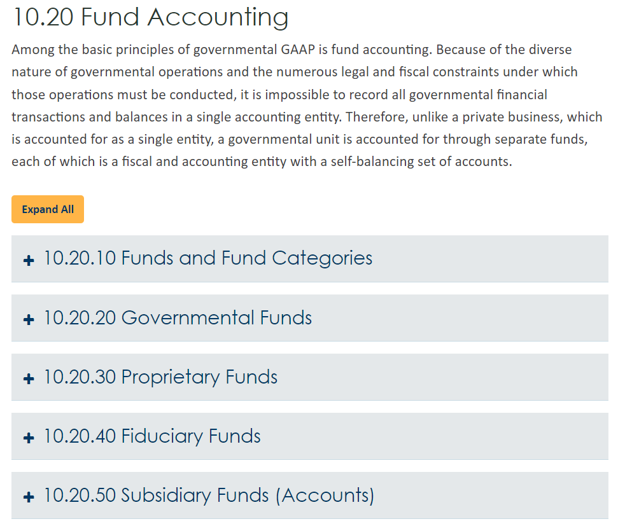
FUNDS
CLAM-FUND-ACCOUNTING

Slide 5
FUNDS (continued)
CLAM-CHART OF ACCOUNTS-FUNDS
5 Fund Types
Fund Type 1
a. Governmental
b. General Fund, Capital Fund, Special Revenue
c. Treasury
d. Example: 001, 08A, 24J, 060, 057, 561

Slide 6
FUNDS (continued)
Fund Type 2
a. Governmental
b. Permanent
c. Local
d. Example: Fund 843 – Exceptional Faculty Endowment
Fund Type 3
a. Governmental
b. Special Revenue
c. Local
d. Example: Fund 145, 148, 149

Slide 7
FUNDS (continued)
Fund Type 4
a. Proprietary
b. Internal Service and Enterprise
c. Local
d. Example: Fund 443, 460, 522, 569
Fund Type 5
a. Clearing/Suspense and Fiduciary
b. Custodial
c. Local
d. Example: Fund 790 and 840

Slide 8
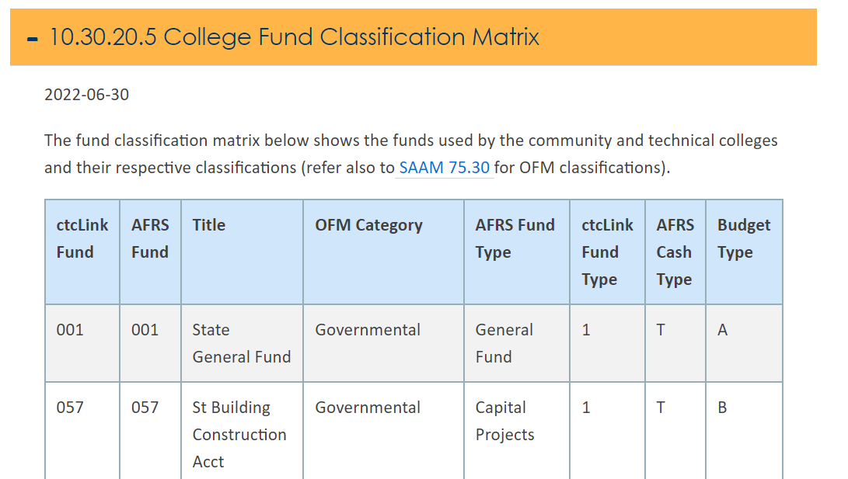
FUNDS (continued)
CLAM-CHART OF ACCOUNTS-FUNDS

Slide 9
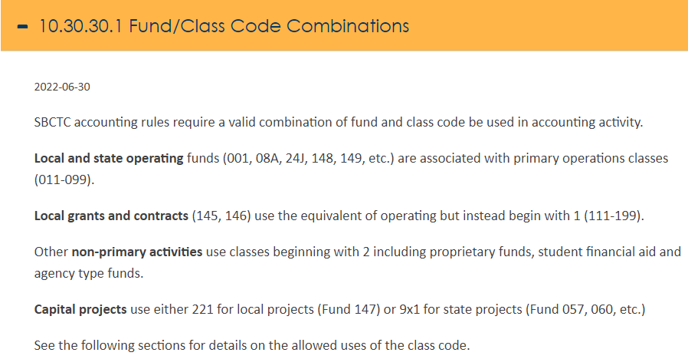
Class code
The Clam manual outlines the appropriate class code that may be used with various funds.
CLAM-CHART OF ACCOUNTS-CLASS CODE

Slide 10
Class code (CONTINUED)
CLAM-CHART OF ACCOUNTS-CLASS CODE

Slide 11
Class code (CONTINUED)

Slide 12
Student aid
Student aid is usually found following funds:
Fund 846 – Financial Aid
Fund 849 – Loans
Fund 145 – Grants – where the grant outlines the use of the funds to support student aid
State appropriated Funds – where the appropriated funds have outlined the use of the funds as outlines by the college’s allocation
Student aid should not be found in fund 149, 148

Slide 13
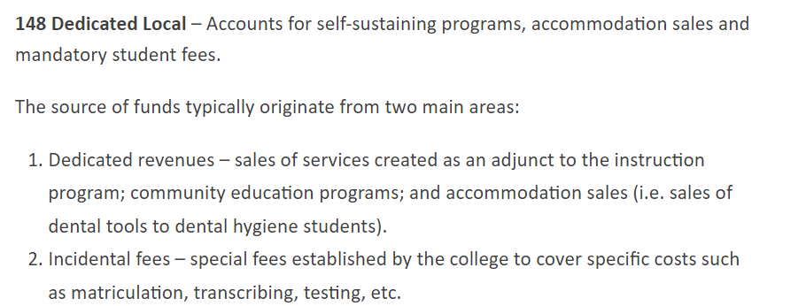
Fund 148
Example: Student voted technology fees are housed in fund 148
Fees associated with a specific course
Continuing education program fees

Slide 14
Fund 149
Allowable revenues in fund 149 are tuition and interest
Interfund transfers from 149 are impermissible
In general, expenditures in 149 support the same types of expenditures in state allocated funds and may be transferred to exhaust general state allocated funds at year end.

Slide 15
Impermissible transactions
State allocated operating and capital funds:
Interfund transfers – 4030150 and 4030140
Short term interfund loan transactions - 1010170/2012040
Long term interfund loan transactions - 1100030/2130030
Below may not be used in the same fund:
Short term interfund loan transactions - 1010170/2012040
Long term interfund loan transactions - 1100030/2130030

Slide 16
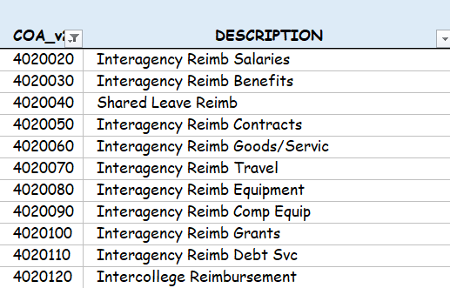
Impermissible transactions (continued)
Internal service/Propriety Funds
Revenues that are reported in AFRS as reduction of expense:

Slide 17
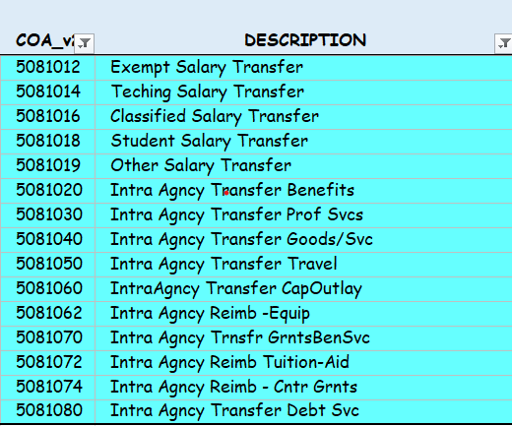
Impermissible transactions (continued)
Internal service/Propriety Funds
T transfers that creates a credit expenditure:

Slide 18
Impermissible transactions (continued)
Cash transactions are impermissible in funds 997 and 999
The below accounts are permissible in funds 4xx, 5xx and 999

Slide 19
Questions
Do we have any questions?

Slide 20
Year-end
Year-end is coming and OFM is focusing on the following:
Cash balances
Assets in credit positions
Liabilities in debit positions
Accounts with unchanged balances

Slide 21
Year-end (continued)
Year-end is coming and OFM is focusing on the following:
Miscellaneous revenue is high on the list as the current system balance for FY2024 is $8.9 million
A portion of the current balance is due to credit card rebates. A new account is established to record these revenues 4030165. Colleges should move all rebates to this account prior to April month end.
The remaining $8.9 million will need to be addressed to decrease it to a minimal level of less than $100,000 per fund for the entire system.

Slide 22
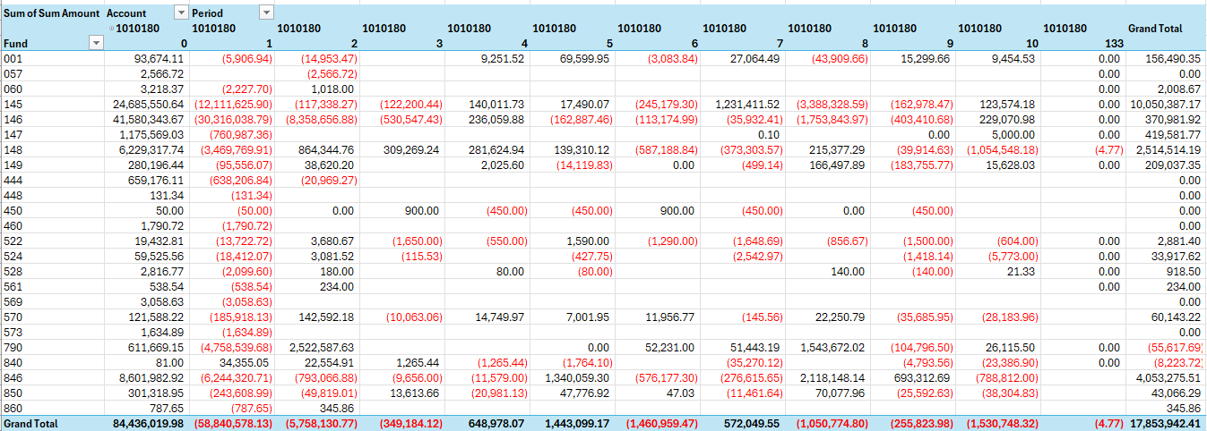
Year-end (continued)
Review account 1010180 for your college.

Slide 23
Questions
Do we have any questions?

Slide 24
Other support & resources
CLAM MANUAL

