Slide 1
Peoplesoft/AFRS Reporting requirements
Sue Willis
Interim ctc-Link System Accounting Manager

Slide 2
TODAY….
AFRS 2022 – Yearend
AFRS 2023 – Going forward & looking back

Slide 3
FY2022
IT’S OVER!!!!!!!

Slide 4
THE GOOD
The SAO acknowledged that our data integrity was greatly improved.
Our OFM consultants have also noted that our data reporting is greatly improved and we are on the right track to getting to our goal of having the system balanced.

Slide 5
ITEMS OF CONCERN
AFRS 2022
The SAO acknowledged our AFRS reporting has improved but the OFM finding for our data will be re-issued.
Cash balances continue to be a point of concern for OFM.

Slide 6
Fy2023 focus and changes
SMARTER 210-Operating Allocations
Begin reconciliation of prior year PeopleSoft data to AFRS
Sunsetting accounts and subsidiaries
Account usage

Slide 7
Fy 2023 sunsetting accounts - subsids
Accounts slated to sunset during FY2023 and will need to be eliminated from the general ledger.

Slide 8
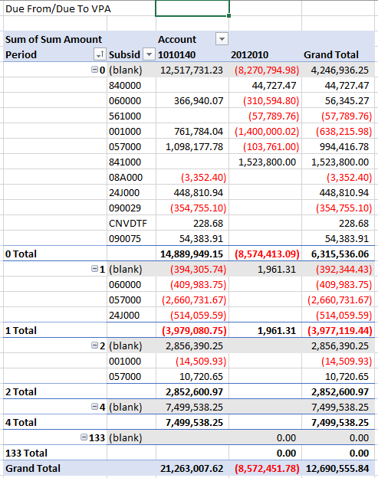
Continued – fy 2023 sunsetting accounts & subsids
Account 1010140 & 2012010 are out of balance at open.
The accounts have been used for transactions in FY2023 and the out of balance number variance is growing

Slide 9
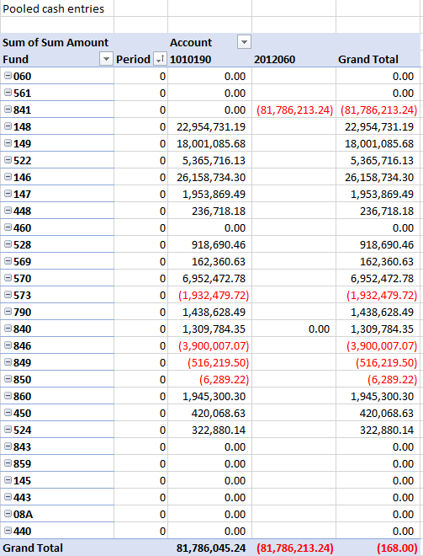
Continued – fy 2023 sunsetting accounts & subsids
Pooled cash just need to be closed out in FY2023.
SBCTC is aware of the out of balance amount and will work with the College to get the item cleared.

Slide 10
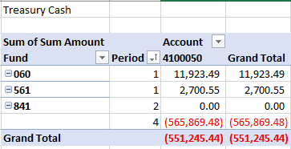
Continued – fy 2023 sunsetting accounts & subsids
Please review your accounts to determine why treasury cash has been used in FY2023.
Subsidiary 000000 will be inactivated by November 30. This is not a subsid that can be transmitted to AFRS and it is getting included in the data transmission.

Slide 11
Impermissible account combinations
Account 4030140 and 4030150 are impermissible for use in fund 790, 840 and 841.
The interfund transfer account 4030140 and 4030150 should not be used with funds 145 and 146. Only use 4030130 as these funds are reported in AFRS as fund 145.

Slide 12
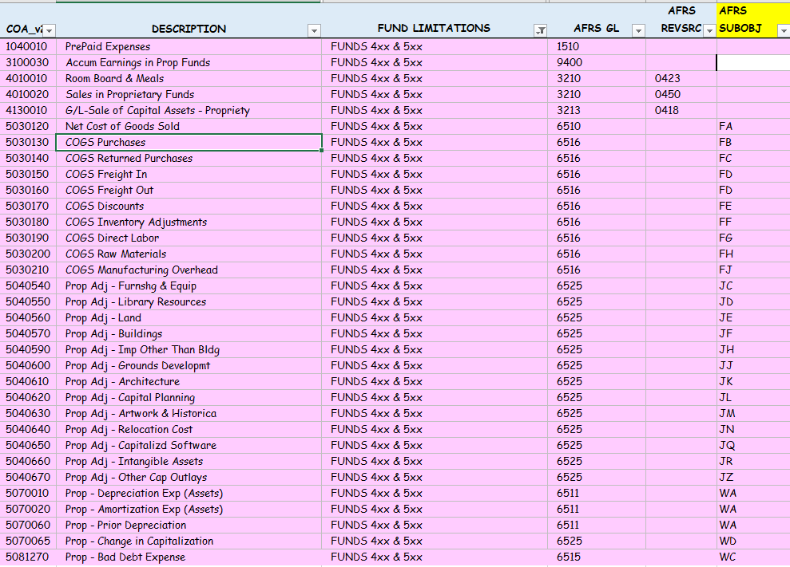
continued - Impermissible account combinations
Accounts for use in 4xx and 5xx funds only:

Slide 13
Funds 146 & 841 change is subsidiary reporting
OFM reporting rolls the following funds together
146 is reported as 145
841 is reported as 840
Accounts that require subsidiaries of due to/due from fund should use the following:
Fund 146 should use subsid 145000
Fund 841 should use subsid 840000

Slide 14
Account 1010170 & 2012040
Account 1010170 & 2012040 are cross walked to the AFRS system as 1353 and 5153. In accordance with the OFM:

Slide 15
Questions
Do we have any questions?

Slide 16
Other support & resources
PeopleSoft GL Query
BAR RESOURCES
BAR SUBJECT MATTER EXPERTS

