Slide 1
Bridge to College: Overview and Update
Articulation and Transfer Council
April 2024
Bill Moore
Director, Bridge to College
SBCTC
Dutch Henry
Bridge to College English
Shoreline CC
Megan Luce
Bridge to College Math Cascadia College

Slide 2
2014 Higher Education Placement Agreement
Defined students to be college-ready based on their scores of 3 or 4 on the Smarter Balanced Assessment (SBA)
For all 34 community and technical colleges (and EWU): SBA score of 2 and a B or better in a Bridge Course also indicates that a student is college-ready
Notes:
System work group fall 2013—original agreement approved in spring 2014, extended in spring 2017—then law changed and the agreement needed to be revised
Revised agreement approved in June 2018

Slide 3
Rationale for Placement Agreement
Dissatisfaction with existing placement tools and ongoing move toward “multiple measures”
Quality of Common Core standards and Smarter Balanced assessments
Opportunity to address college readiness issues with K-12 partners
Notes:
System work group fall 2013—original agreement approved in spring 2014, extended in spring 2017—then law changed and the agreement needed to be revised
Revised agreement approved in June 2018

Slide 4
Bridge to College Courses
Pathway for students scoring below “college-ready” on the high school assessment
Jointly developed and coordinated by college faculty and high school teachers
Ongoing professional learning support for teachers
Bridge to College Initiative Web Site
Notes:
Math and English
Professional Learning System:
The Bridge Course Trainers are supported by a leadership partnership between OSPI (Teaching and Learning) and the State Board of Career and Technical Colleges.

Slide 5
2018 Legislative Changes
Moved high school assessment to 10th grade, affecting the placement agreement
De-linked high school assessment (SBA) from high school graduation and substituted new “pathway” requirements
Notes:
Shifting high school assessment to 10th grade affects placement agreement
New 10th grade threshold scores
Changes in the math assessment for 10th grade version
Bridge to College courses as one of 8 graduation pathways:
SBA scores
Dual credit courses (CHS and Running Start)
Bridge to College
AP/IB courses and tests
SAT/ACT scores
Any combination of other 7
Armed Services Vocational Aptitude tests
Career and Technical Education courses

Slide 6
HS GRADUATION REQUIREMENTS
Formalizes requirement for students to complete 1 of 8 graduation pathway options:
SBA scores
Dual credit courses (CHS and Running Start)
Bridge to College
AP/IB courses and tests
SAT/ACT scores
Armed Services Vocational Aptitude tests
Career and Technical Education courses
Any combination of other 7 options

Slide 7
Revised System Placement Agreement
Eliminated requirement of Smarter Balanced score for placement with Bridge to College
Added course success requirements for math in addition to Smarter Balanced score
Extended initially through Class of 2022 (in 2023 system extended agreement through 2027)
Notes:
See handout for specific language:
Algebra 2 (with a B or better)
Added expectation of passing math course in junior or senior year
Revised prerequisite expectation for placement into math courses other than &107/&146 (B or better in HS precalc or higher)

Slide 8
BTC OVERALL PARTICIPATION TRENDS
School Year | Districts | High Schools | Math Teachers | English Teachers
2017-18 | 89 | 138 | 247 | 121
2018 -19 | 111 | 188 | 234 | 196
2019-20 | 121 | 203 | 263 | 222
2020-21 | 121 | 202 | 236 | 183
2021-22 | 115 | 188 | 213 | 210
2022-23 | 108 | 174 | 192 | 202
2023-24 | 107 | 170 | 202 | 189

Slide 9
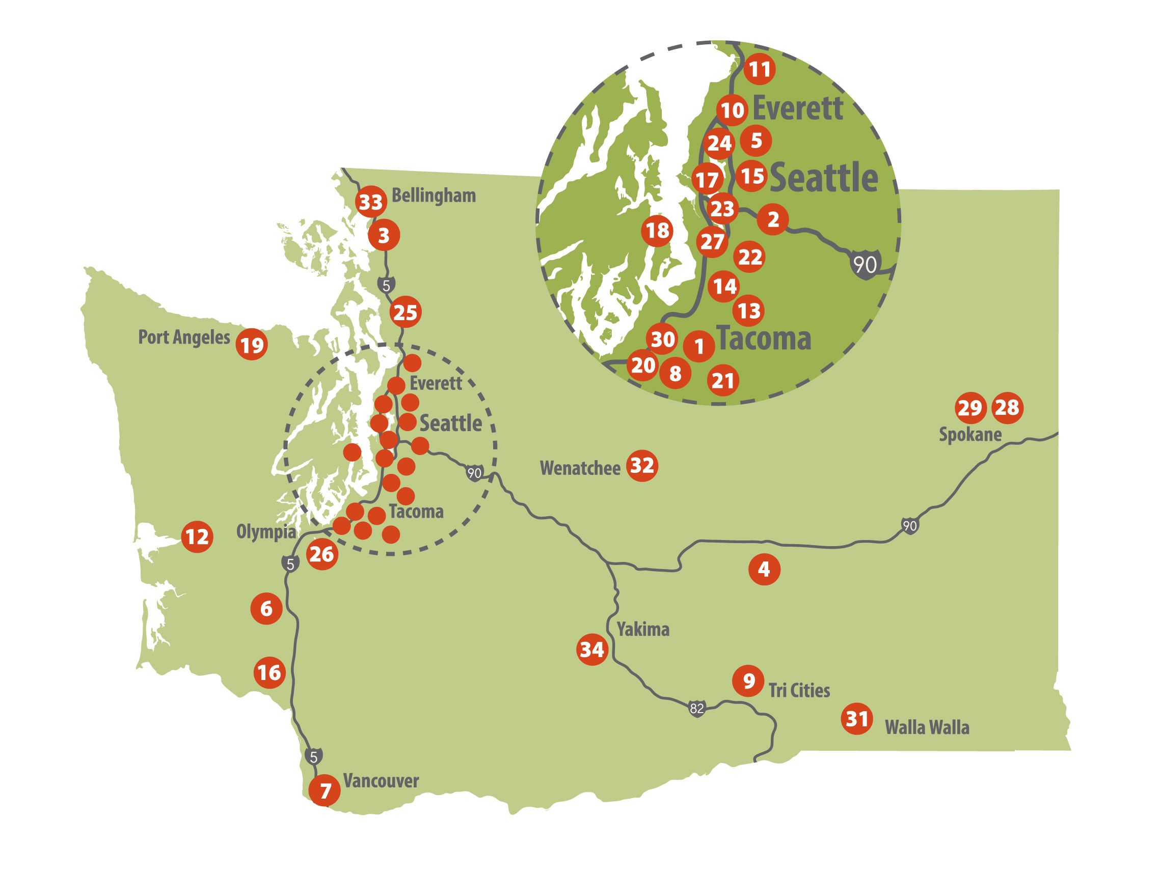
Bridge to College Statewide
21
8
51
11
27
13
11
18
10
# of Bridge to College high schools by ESD

Slide 10
Bridge to College Courses
Collaboration: High school teachers and higher ed faculty work closely on shared teaching and learning challenges
Higher Ed Use: Curriculum used in some Basic Ed and pre-college programs
Higher Ed Outreach: BTC teachers work with CC faculty, meet on our campuses, observe classes

Slide 11
Bridge to College Math Curriculum
Units of Study:
Statistics
Algebraic Expressions
Equations
Proportional Reasoning
Linear Functions
Systems of Equations
Exponential Functions and Logarithms
Quadratics (optional)
Standards for Mathematical Practices embedded
Emphasis on Social and Emotional learnings
Notes:
The course materials can also be, and have been, used in their own precollege programs

Slide 12
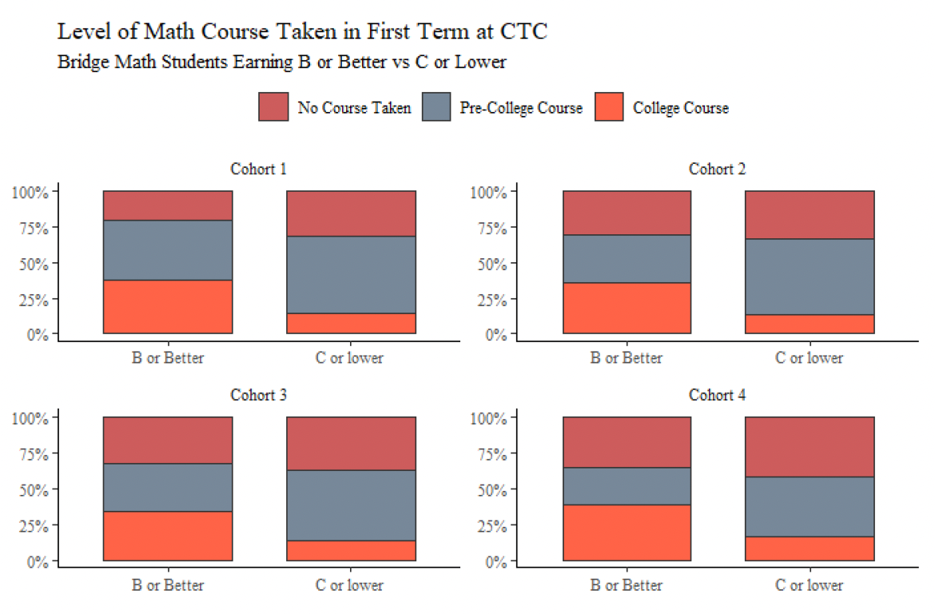
BtCM Data on College Course-Taking
Notes:
2015-16 (803 students, B or better, of 1055 total)
16-17 (1327 of 1768)
17-18 (1558 of 2055)
18-19 (3410 of 4587)
Students positive about the support and instruction offered, indicating courses helped them develop a growth mindset and become more effective students
BtC students statistically more likely to enroll in college-level Math than their (comparison group) peers
71% of successful (B or better) BtC Math students with Level 2 SBA scores earned a “C” or better in 1st-quarter college level math course, similar to their comparison group peers

Slide 13
Bridge to College English Curriculum
Rhetorical reading and writing
Modules support students from pre-reading to post-writing reflection
Challenging, diverse non-fiction and fiction texts, including contemporary topics and ssues tied to local communities
Emphasis on expository and argumentative writing for multidisciplinary writing
Notes:
California State University system partnership

Slide 14
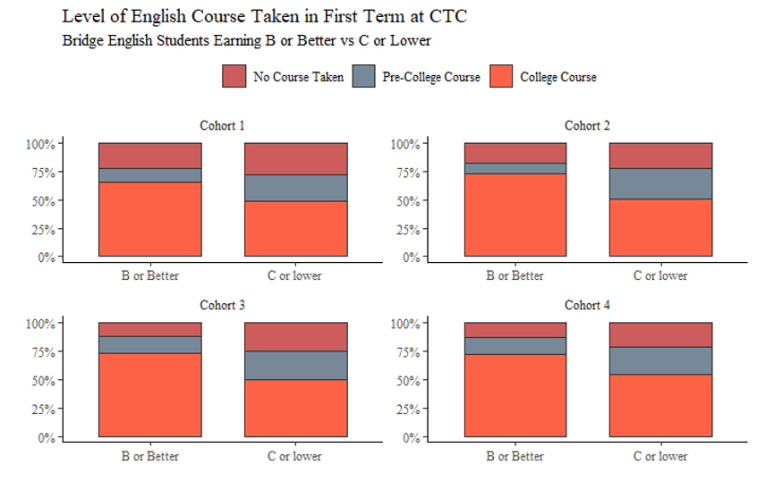
BtCE Data on College Course-Taking
Notes:
2015-16 (803 students, B or better, of 1055 total)
16-17 (1327 of 1768)
17-18 (1558 of 2055)
18-19 (3410 of 4587)
Students positive about the support and instruction offered, indicating courses helped them develop a growth mindset and become more effective students
BtC students statistically more likely to enroll in college-level Math than their (comparison group) peers
71% of successful (B or better) BtC Math students with Level 2 SBA scores earned a “C” or better in 1st-quarter college level math course, similar to their comparison group peers

Slide 15
Ongoing Challenges
How can these barriers be mitigated with our current work?
Burden on students to provide transcripts
Communication issues with high school and college staff
Inconsistent use of high school transcripts
Variations in local score reporting formats, processes
Notes:
Guided pathways work; K-12 outreach efforts, College Spark-funded math placement project

Slide 16
Significance of BtC Courses
For colleges, a crucial outreach and communication opportunity with students who have signaled an interest in college but often don’t enroll after high school.
For students, an engaging and challenging opportunity that will help them be successful in their entry-level college courses
For teachers, strong professional learning through a network of high school teachers along with an active partnership with higher education faculty
For schools and districts, well-designed, low-cost, open-source curricula for students interested in attending college but uncertain of how well they will do there.
Notes:
The course materials can also be, and have been, used in their own precollege programs

Slide 17
QUESTIONS?
Contact: Bill Moore
bmoore@sbctc.edu
(W) 360.704.4346
(C) 360.528.1809

